Slide 1
Gastric Ultrasound
Alok Moharir, M.D.
Department of Anesthesiology
Nationwide Children’s Hospital
Columbus, OH

Slide 2
I-AIM Framework
I: Indication
  Diagnostic question
  E.g. Full or Empty Stomach
A: Acquisition
  Correct views
  Specific structures to assess
I: Interpretation
  How to differentiate an empty vs full stomach
M: Medical Decision Making
  How the information obtained can guide patient management
A, Van de Putte P, Van Houwe P, Chan VWS. I-AIM framework for point-of-care gastric ultrasound. British Journal of Anaesthesia. 2016 January; 116 (1): 7-11.

Slide 3
Indications
Urgent or emergent procedures
  May have to proceed with surgery before adequate NPO times
  Delayed gastric emptying in acutely ill patient
Co-Morbidities with delayed gastric emptying
  Diabetes Mellitus
  Neuromuscular disorders
  Trauma
  Gastric dysmotility
  Medications which may delay gastric emptying
    Narcotics
    GLP-1 Agonists
Unclear NPO status due to decreased LOC or cognitive dysfunction
Questionable compliance with NPO status

Slide 4
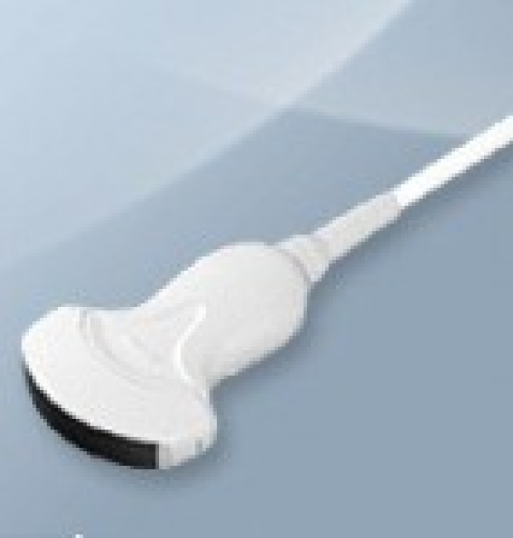
Equipment
Curvilinear Probe
  Lower frequency, deeper penetration
  3-5 MHz
  Suitable for most adults and children

Slide 5
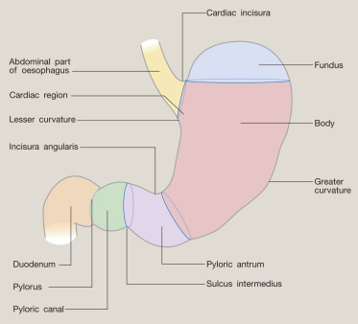
Gastric Anatomy
Antrum typically visualized
  Superficial location
  Lower air content
  Most dependent region of stomach
    Gastric content gravitates towards it
  Provides information about rest of stomach
    Type and volume of stomach content
Image Source: Davinder Ramsingh. Foresight Ultrasound. Referenced on 14 January 2025. https://www.dropbox.com/scl/fi/sg9pyebr3hcgs1g2j9ft5/17.-Ultrasound-for-Gastric-Volume.ppsx?rlkey=ft0fp8q0knzf5wyn872qejd3n&e=1&dl=0

Slide 6
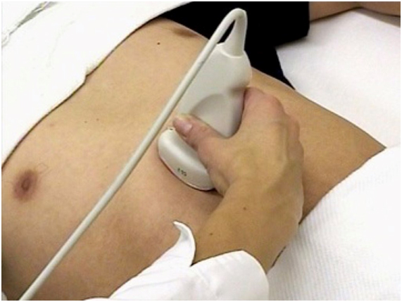
Scanning Technique
Epigastric region
  Subxiphoid
Sagittal scan
Orientation Marker of probe pointing cranially
Transverse cross sectional view of gastric antrum
Sweep from left to right subcostal margins
  Until key landmarks obtained (next slide)
Once antrum visualized:
  Rotate transducer clockwise and counterclockwise
  Maximize short axis cross sectional view

Slide 7
Patient Positioning
Supine
  Can rule in a full stomach, but cannot rule out
  Some content might be in fundus
Right lateral decubitus
  Promotes gravitational drainage
  Rule out full stomach; verify empty stomach
Alternative to RLD
  Positioning not feasible
    Trauma
    Hemodynamic, respiratory instability
    Traction devices
  Semirecumbent position: 45 degrees head up

Slide 8
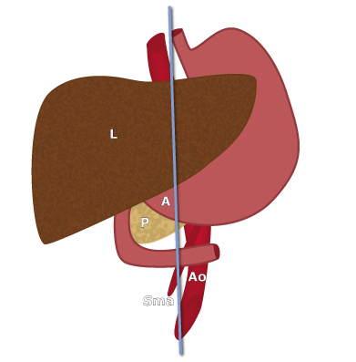
Cross Sectional Anatomy
Target Landmarks
  L: Liver
    Inferior margin of Left Lobe
    Serves as acoustic window
  A: Gastric Antrum
    Short Axis
  P: Pancreas
    Head/Neck Region
  SMA: Superior Mesenteric Artery
    Long Axis
  Ao: Aorta
    Long Axis
Image Source: Peter van de Putte, Lionel Bouvette. Gastric Ultrasound Applied Antomy. Referenced on January 22, 2025. https://www.gastricultrasound.org/en/acquisition/#scanning

Slide 9
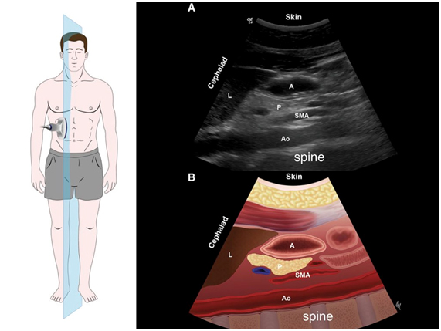
Sonoanatomy
Orientation Indicator on top left of screen (Cephelad)
RA: Rectus Abdominis Muscle
A: Gastric Antrum
  Transverse, cross sectional view (short axis)
L: Liver
  Antrum inferior to the left lobe
  Usually posterior to the left lobe
Gastric Antrum often anterior to the:
  P: Pancreas
  Ao: Aorta
    Pulsatile
    Thick walled
    Retrohepatic
  IVC (Not pictured)
  SMA: Superior Mesenteric Artery
    Branch of the Aorta
  Spinal Vertebrae
RA
Image Source: Cubillos J, et al. Can J Anaesth. 2012; 59: 416-423

Slide 10
Scanning Tips
Liver is often the easiest landmark to locate
Scan until edge of left lobe visualized
  Slide transducer cephalad to caudad
Gastric Antrum usually along left border of lobe
  At the same sagittal scanning plane as the Aorta

Slide 11
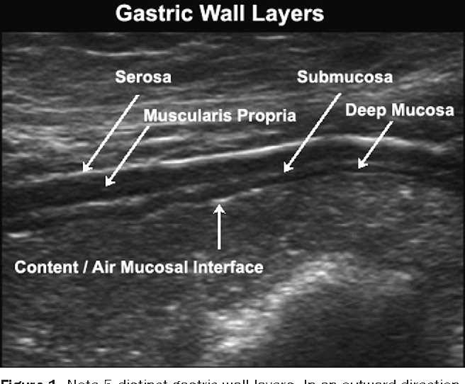
Gastric Wall Layers
From outside to inside:
  Serosa: Hyperechoic
  Muscularis Propria: Thick, Hypoechoic
  Submucosa: Hyperechoic
  Muscularis Mucosa: Hypoechoic
  Mucosal-Air Interface: Hyperechoic
Image Source: Perlas A, et. al. Gastric Ultrasonography in the Fastred Surgical Patient: A Prospective Descriptive Study. Anesthesia and Analgesia. July 2011; 113: 93-97

Slide 12
Stomach vs Colon
Stomach
  Thicker muscular wall
  More hyperechoic
  Well defined internal folds
    Especially when empty
  More superficial location
Colon
  Usually inferior to the stomach
  Thinner, hazy outer wall
  Lack of internal folds

Slide 13
Interpretation of Gastric Content
Qualitative Assessment
  Empty
  Clear Fluid
  Solids
Positioning
  Supine: Can underestimate aspiration risk
  Right Lateral Decubitus
    Gastric content moves to the Antrum in this position,
    Note: If solid food found in supine position then no need to position patient RLD as high aspiration risk can already be ascertained

Slide 14
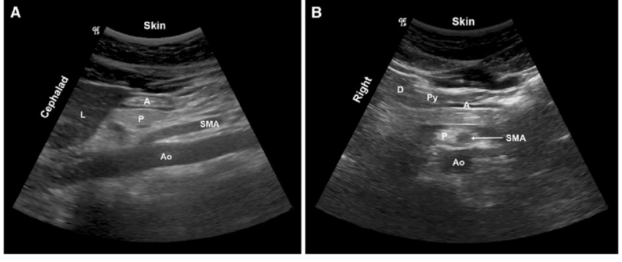
Empty Stomach
L: Liver
A: Antrum
Antrum is small, flat, and collapsed
  Prominent surrounding muscular wall
  Can occasionally see gastric folds within the antral lumen
“Bulls-Eye” appearance
  Round or ovoid cross section
Low risk of aspiration
Image Sources (14-17):: Peter van de Putte, Lionel Bouvette. Gastric Ultrasound types of Gastric Content.. Referenced on January 28, 2025. https://www.gastricultrasound.org/en/acquisition/
:

Slide 15
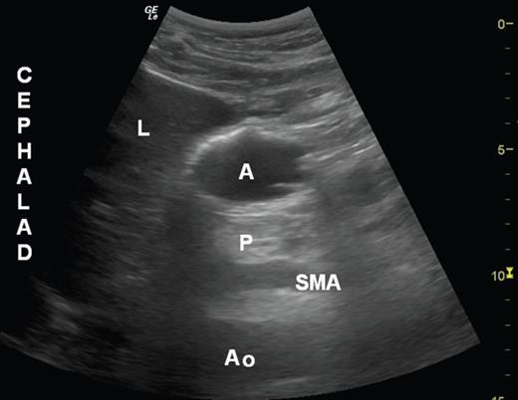
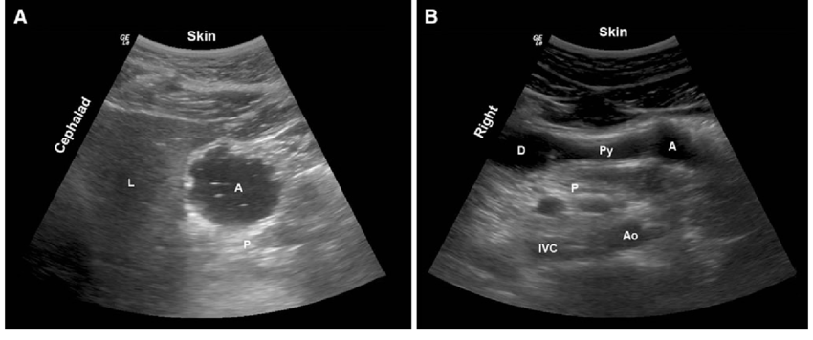
Clear Fluid
Hypoechoic and homogenous (top image)
  Occasional swallowed air mixed in (bottom image)
    Hyperechoic dots
    “Starry Sky” appearance
Many will have clear gastric secretions
  Can occur even in fasting state
  Appears similar to clear liquids
  Clinically significant if > 1.5 ml/kg gastric volume
    Carries higher risk of aspiration
Antrum becomes distended
  Thinner walls compared to empty state
Contents
  L: Liver
  A: Gastric Antrum
  P: Pancreas
  Ao: Aorta
  SMA: Superior Mesenteric Artery

Slide 16
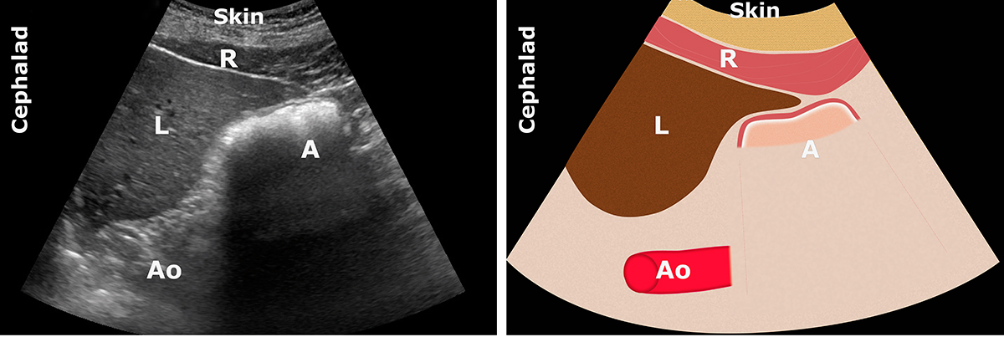
Frosted Glass Pattern
Immediately after a meal
Swallowed air mixed with solid food
Can obscure deeper structures
Contents
  R: Rectus Abdominis muscle
  L: Liver
  A: Gastric Antrum
  Ao: Aorta
Air later gets absorbed
  Can then more clearly see gastric antrum circumference, gastric activity, and gastric contents (next slide)

Slide 17
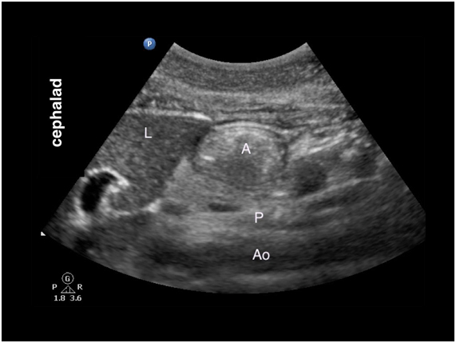
Thick Fluid or Solid
Any amount of solid or thick fluid is aspiration risk
  No need to quantitatively measure the content
Thick Fluid
  Hyperechoic
  Homogenous
Solid Food
  Particulate content
  Heterogenous
  Often with solid/fluid interfaces
Can often see peristaltic activity

Slide 18
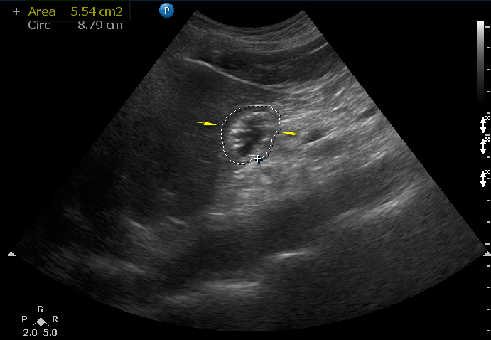
Measuring Gastric Fluid Volume
Fasted patients can have baseline gastric secretions
Taken in RLD position
  Between peristaltic activity
  Freeze image at maximum circumference
  Measure from serosa to serosa
Free trace border of gastric wall
  Standard ultrasound calipers
Cross sectional area (CSA)
  Measured in cm²
  Direct correlation with volume of gastric fluid (ml)
Volume (ml) = -7.8 + (3.5 X RLD CSA cm2) + (0.127) X age (mos)
Perlas A, et al. I-AIM Framework for point-of-care gastric ultrasound. British Journal of Anaesthesia. 2016; 116: 7-11.

Slide 19
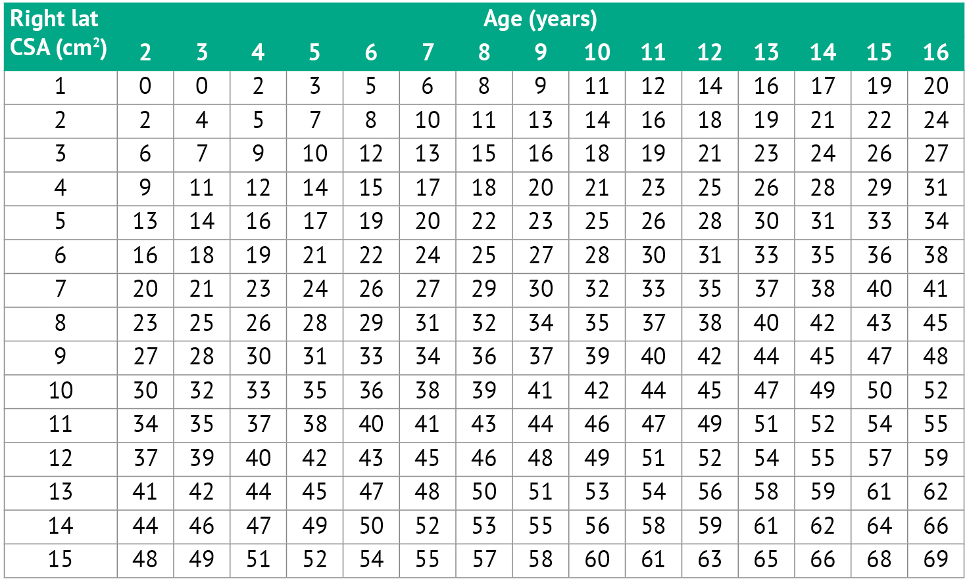
Gastric Fluid Volume in the Pediatric Patient (ml)
Image Source: Peter van de Putte and Lionel Bouvette. Gastric Ultrasound (Pediatric Patients). Referenced on January 28, 2025. https://www.gastricultrasound.org/en/special-patients/

Slide 20
Medical Decision Making
Grading System:
Grade 0
  Empty Stomach in both supine and RLD position
  Low risk of aspiration
Clear Fluid
  Grade I
    Volume < 1.5 ml/kg
    Low risk of aspiration
  Grade II
    Volume > 1.5 ml/kg
    High risk of aspiration
Any solid or thick liquid is considered high risk of aspiration
  Quantitative volume measurement therefore not necessary

