Slide 1
INTRODUCTION TO POINT OF CARE ULTRASOUND (POCUS)
Peter Shapiro, MD

Slide 2
Why Should You Care

Slide 3
Scenario A
It’s a Saturday night
87 year old-female presenting for IM nail of right femur fracture sustained 72 hours ago after presumably mechanical fall
She is a poor historian. Thinks Reagan is president
Harsh systolic murmur loudest at the right upper sternal border (or is it left upper sternal border)
What’s your differential? What do you do?

Slide 4
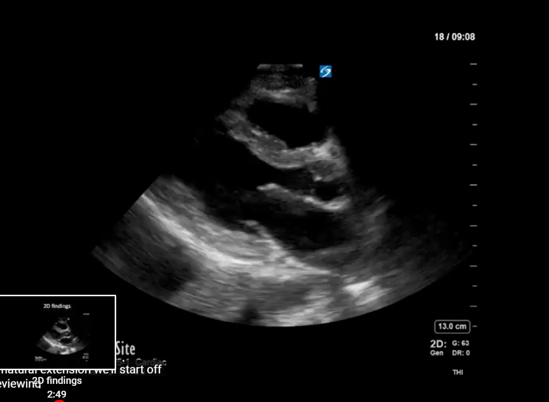
Point-of-Care Ultrasound A
Notes:
Normal

Slide 5
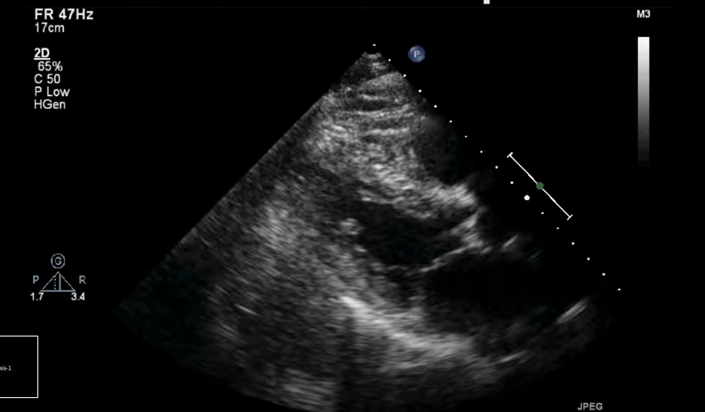
Point-of-Care Ultrasound B
Source: https://www.youtube.com/watch?v=RDPaeCqfA2Y&t=196s
Notes:
Aortic stenosis

Slide 6
Scenario B
45 year-old female with HTN, HLD, COPD and heart block presents pacemaker placement under MAC
He is on home O2 and smokes three pack of cigarettes per day. Quit in the parking lot
Allergic to bananas, latex, PCN, ketorolac, acetaminophen, lidocaine, epinephrine, Benadryl, eggs
Coughs during lead placement, becomes dyspneic, hypoxic and progressively more hypotensive
What’s your differential? What do you do?

Slide 7
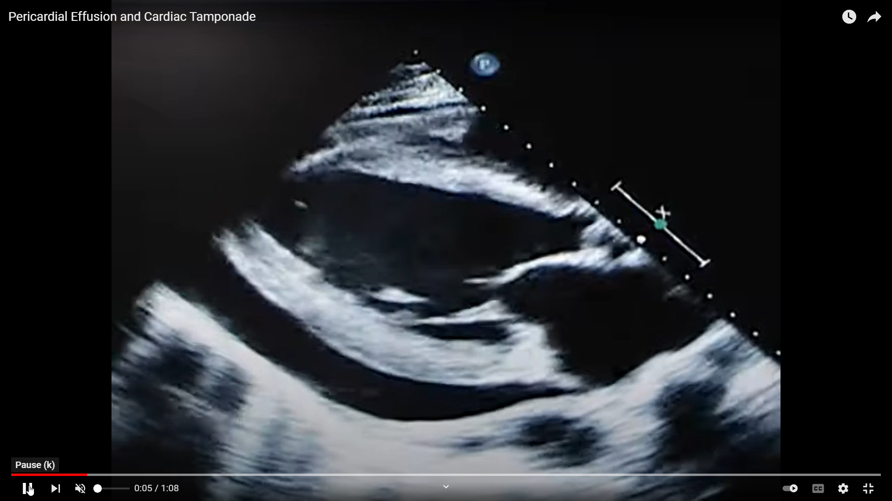
Point-of-Care Ultrasound
Source: https://www.youtube.com/watch?v=QjqrO71mg0k
Notes:
Cardiac Tamponade

Slide 8
GOALS AND OBJECTIVES
Learn basics of point-of-care (POCUS) ultrasound
Become competent performing basic transthoracic heart, lung, gastric and FAST exams
Distinguish normal from abnormal anatomy and function
Identify significant pathology that may alter anesthetic care
Incorporate point of care ultrasound into your own future practice
Have necessary skill and knowledge to pass OSCE portion of the ABA oral board exam (covering focused cardiac, lung, gastric, FAST exams)
Notes:
Physical exam and history and physical have poor sensitivity for detecting heart disease and heart failure

Slide 9
GOALS AND OBJECTIVES
Learn basics of point-of-care (POCUS) ultrasound
Become competent performing basic transthoracic heart, lung, gastric and FAST exams
Distinguish normal from abnormal anatomy and function
Identify significant pathology that may alter anesthetic care
Incorporate point of care ultrasound into your own future practice
Have necessary skill and knowledge to pass OSCE portion of the ABA oral board exam (covering focused cardiac, lung, gastric, FAST exams)
Stethoscope of the future
Notes:
Physical exam and history and physical have poor sensitivity for detecting heart disease and heart failure

Slide 10
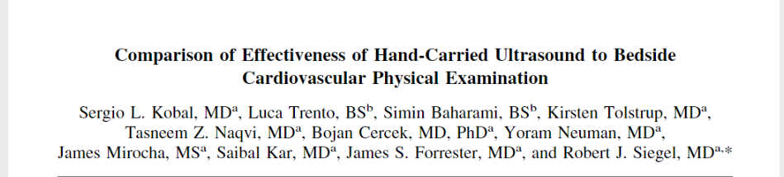
Compared medical students with a hand-held ultrasound against cardiologist with a stethoscope in accurately making a CV diagnosis
Medical students correctly identified 75% of cardiac pathologies
Cardiologist using physical exam alone identified 49% of pathologies
Medical students with a hand-held ultrasound out-performed cardiologists performing physical exams in detecting valvular disease, LV dysfunction, ventricular enlargement and hypertrophy
Notes:
Here is a study that illustrates how useful and effective point-of-care ultrasound can be

Slide 11
Compared medical students with a hand-held ultrasound against cardiologist with a stethoscope in accurately making a CV diagnosis
Medical students correctly identified 75% of cardiac pathologies
Cardiologist using physical exam alone identified 49% of pathologies
Medical students with a hand-held ultrasound out-performed cardiologists performing physical exams in detecting valvular disease, LV dysfunction, ventricular enlargement and hypertrophy
Notes:
Here is a study that illustrates how useful and effective point-of-care ultrasound can be

Slide 12
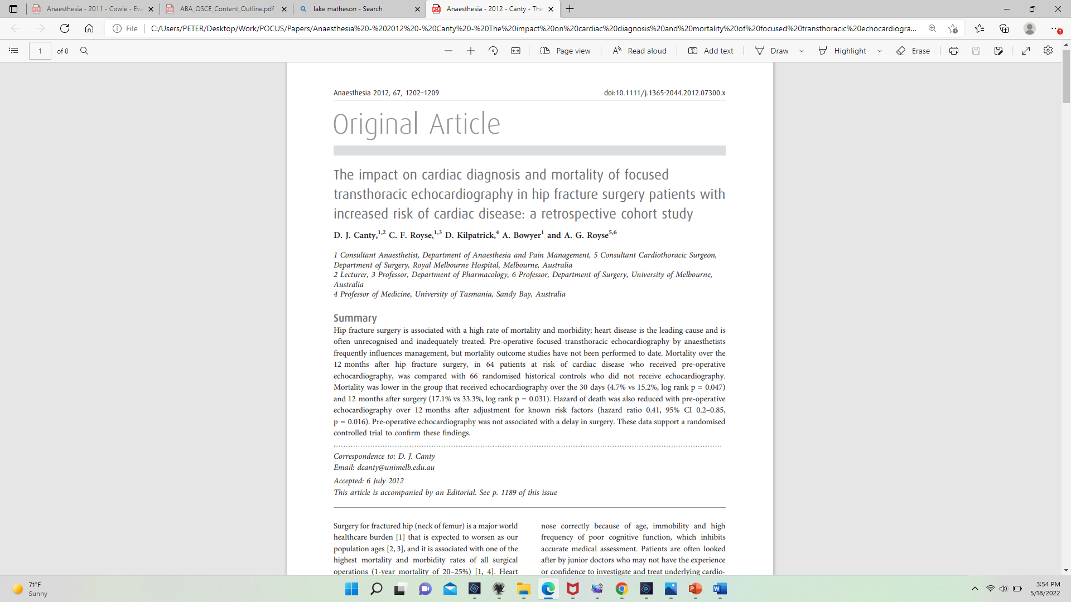
Retrospective study comparing mortality after hip fracture surgery in patients who did or did not receive a pre-operative focused transthoracic ultrasound (FoCUS)
Mortality lower in the group that received echocardiography after 30 days (4.7% vs 15.2) and 12 months after surgery (17.1% vs 33.3%)
Correctly identified life threatening pathology, including hypovolemia (34%), cardiac failure (20%), pulmonary hypertension (11%) and aortic stenosis (14%)
Preoperative FoCUS changed anesthetic management in more than half of the patients (i.e. GA vs spinal for critical AS) and likely altered post-operative care (all without delaying surgery)

Slide 13
Retrospective study comparing mortality after hip fracture surgery in patients who did or did not receive a pre-operative focused transthoracic ultrasound (FoCUS)
Mortality lower in the group that received echocardiography after 30 days (4.7% vs 15.2) and 12 months after surgery (17.1% vs 33.3%)
Correctly identified life threatening pathology, including hypovolemia (34%), cardiac failure (20%), pulmonary hypertension (11%) and aortic stenosis (14%)
Preoperative FoCUS changed anesthetic management in more than half of the patients (i.e. GA vs spinal for critical AS) and likely altered post-operative care (all without delaying surgery)
Notes:
Retrospective study showing that use of preoperative U/S in this patient population was associated with decreased mortality
The authors of the previous study went on to do a prospective randomized trial….

Slide 14
Trial randomized elderly hip fracture patients to a group that receive a pre-operative focused cardiac ultrasound (FCU) and a control group (No FCU)
Lower mortality at one-year in FCU group (18%) than in the No FCU (29%) group
Simple point-of-care exam associated with a decrease in mortality

Slide 15
Trial randomized elderly hip fracture patients to a group that receive a pre-operative focused cardiac ultrasound (FCU) and a control group (No FCU)
Lower mortality at one-year in FCU group (18%) than in the No FCU (29%) group
Simple point-of-care exam associated with a decrease in mortality
Notes:
Pre-operative U/S is non-invasive, does not delay surgery, changes patient management

Slide 16
HOW HARD IS POINT-OF-CARE ULTRASOUND?

Slide 17
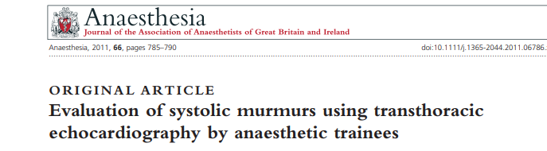
Compared performance of anesthesia residents to that of cardiac anesthesiologists in detecting severe aortic stenosis
Trainees received two hours of lecture and one hour of hand-on training
There was 100 percent agreement between residents and cardiac anesthesiologists in assessing severity of aortic stenosis
Notes:
THE POINT IS THAT LEARING U/S IS EASY. Novice users able to achieve an “acceptable” skill level in focused cardiac ultrasound after performing 20-30 limited cardiac examinations

Slide 18
Perioperative Applications of POCUS
 | Preoperative | Intraoperative | Postoperative
Cardiac | Pericardial disease LV or RV function Regional wall abnormalities Severe valvular disease Volume status | Ventricular dysfunction Regional wall motion abnormalities Changes in volume status New Tamponade | Hemodynamic instability
Lung | Pleural effusions Interstitial syndrome Pulmonary edema | Pneumothorax Hemothorax Pulmonary edema | Pneumothorax Hemothorax Pleural effusion Pulmonary edema
Abdominal | Gastric content/volume Free fluid/hemoperitoneum Free air |  | Intraabdominal hemorrhages Ruptured viscera

Slide 19
Why Learn Point-of-Care Ultrasound?
Well, because you are a resident and have no choice….
Easy to learn
Will identify significant pathology
Will change intraoperative and post-operative management in selected patients
Your patients will receive better care and (maybe) have better outcomes
Unlikely to cause significant delays in work-flow
Requires minimal investment in time and resources
It will make you a better anesthesiologist

Slide 20
Why Learn Point-of-Care Ultrasound?
Well, because you are a resident and have no choice….
Easy to learn
Will identify significant pathology
Will change intraoperative and post-operative management in selected patients
Your patients will receive better care and (maybe) have better outcomes
Unlikely to cause significant delays in work-flow
Requires minimal investment in time and resources
It will make you a better anesthesiologist

Slide 21
Transthoracic Echo Objectives
  Focused Assessment Transthoracic Echocardiography:
    Gross biventricular function and regional wall motion abnormalities
    Fluid status
    Pericardial free space
    Gross valvular pathology
    Evidence of volume and pressure overload of the RV
Gastric:
  Presence of fluid or solids
Lung:
    Pneumothorax, inadequate ventilation, increased lung density (from a variety of causes), pleural fluid
FAST exam:
  Intraabdominal free fluid

Slide 22
Expectations
    Residents are encouraged to seek out cases in collaboration with faculty members
    Locations where patients may be scanned:
        Pre-operative area if time allows
        Intra-operatively in the case of hemodynamic instability (attending presence required)
        Stable patients during non-critical portions of the case when you have access to the chest
        PACU
Consent NOT required to examine a patient in the perioperative settings
Goal: 25 transthoracic, 10 lung, 5 FAST, 5 gastric exams by the end of residency

Slide 23
Key Consideration
    Point-of-care-ultrasound is not a comprehensive exam
    Aims to answer a specific question (e.g. why is patient hypotensive) in a focused, goal-oriented, expedient manner*
    Clinical applications involve:
    Procedural guidance: invasive procedures (vascular access, peripheral nerve blocks, etc)
    Diagnostic: used to narrow differential diagnosis and guide treatment
    Monitoring: serial exams used to monitor a patient’s condition or the effects of a therapeutic intervention (i.e. monitoring intravascular status during cross-clamping of the IVC during transplant, or assessing LV function during cross-clamping of the abdominal aorta)
    Resuscitation: under-utilized application during cardiac arrest for detecting reversible causes of collapse (i.e. tamponade, tension pneumothorax, massive PE) and prognosis
Notes:
* Perfect for anesthesiologists. I don’t care what the proximal iso velocity surface area of a valve orifice is, or which aortic valve leaflet is messed up, I just want to know if there’s hemodynamically significant aortic valve stenosis

Slide 24
BASIC ULTRASOUND CONCEPTS

Slide 25
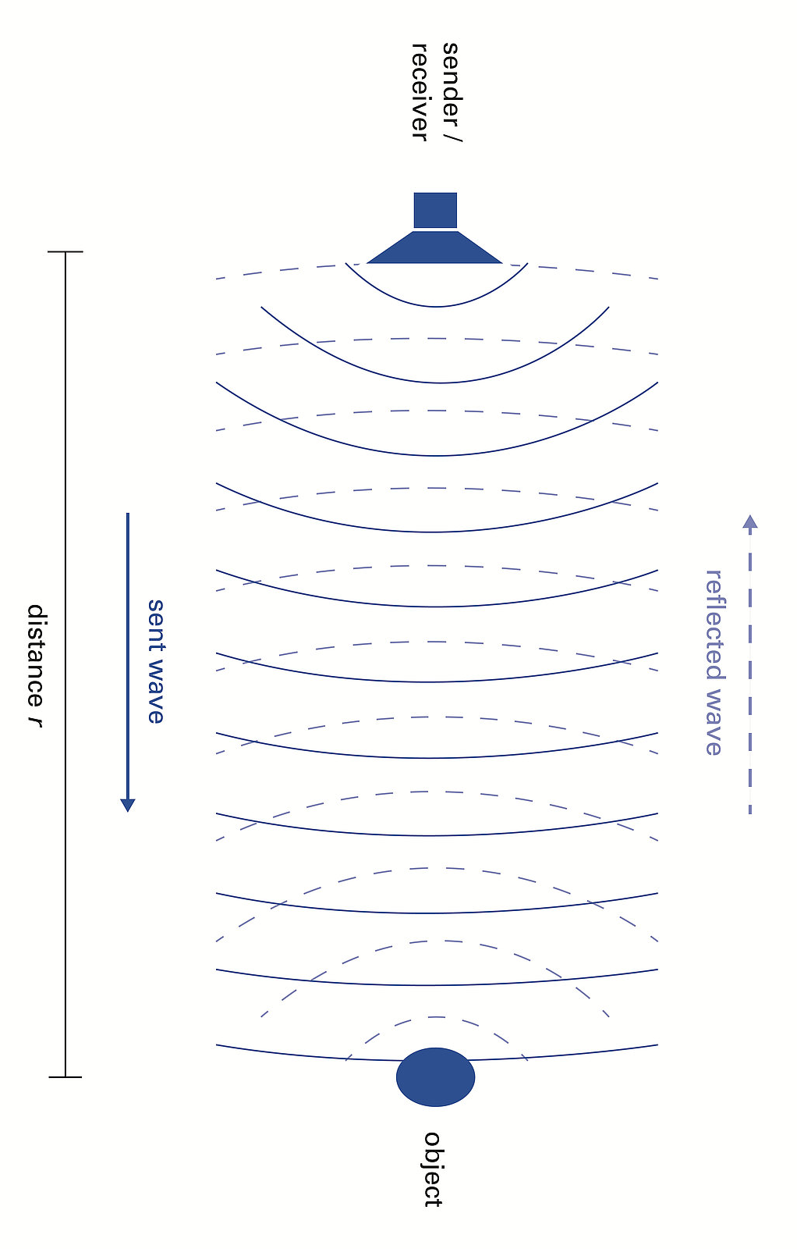

Ultrasound
Piezo-electric effect is cornerstone of traditional ultrasound
Pulsed sound waves emitted by a piezoelectric material (i.e quartz) when an alternative electrical current is applied to the material
Ultrasound waves propagate through media, and reflected ultrasound waves (or echos) are received by the same transducer and converted into electric signals
A computer analyzes the time delay between when the pulse was sent, when the echo was received, properties of the sound itself (i.e. amplitude) to calculate distance and generate an image
Typical range of 2 – 20 mega hertz
Notes:
The piezoelectric effect is the cornerstone of traditional ultrasound. This is an electromechanical property of certain materials like quartz where an electrical current applied through the object generates vibrations resulting in pulsed sound waves. In turn, echos reflected back to the crystal generate changes in electrical resistance and current

Slide 26
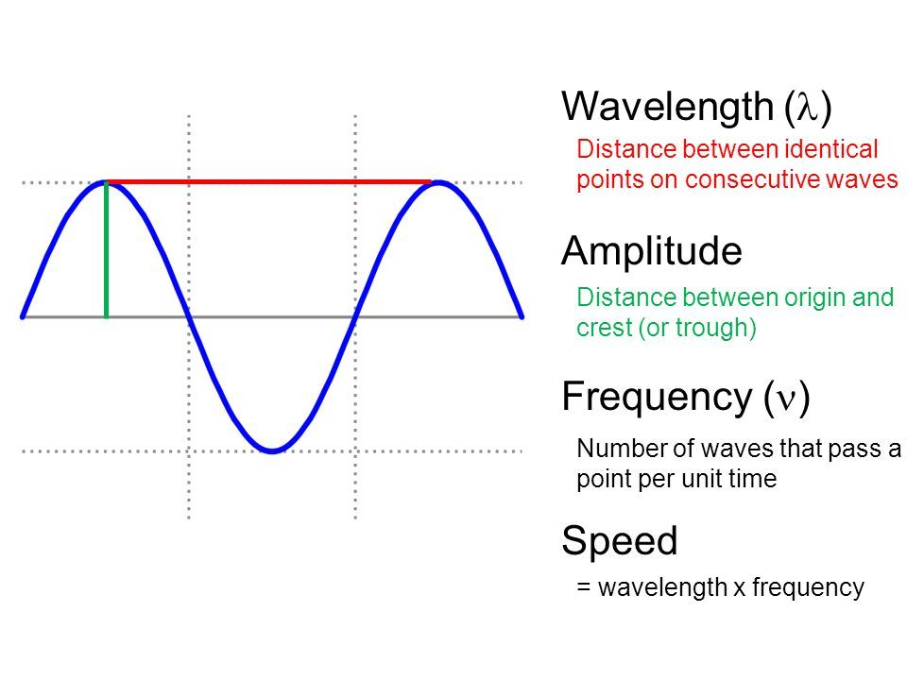
Basic Ultrasound Concepts: Waves
Frequency (f): number of sound wave cycles per second (1-15 MHz in medical ultrasound)
Inversely proportional to wavelength (λ), the distance between identical point on consecutive waves
Ultrasound waves with shorter wavelengths and higher frequencies have better resolution but penetrate to shallower depths
Notes:
Let’s go over the very basics of ultrasound physics

Slide 27
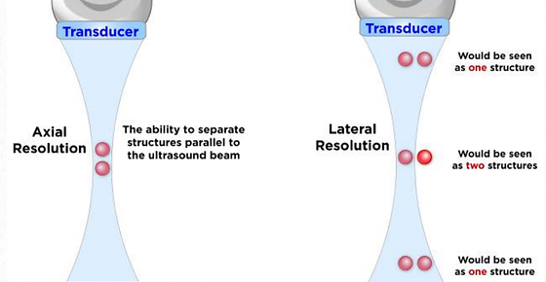
Resolution
Axial resolution refers to ability to differentiate two objects along the axis of the ultrasound beam
Lateral resolution (horizontal resolution) is ability to differentiate two objects perpendicular to U/S beam
Decreases as deeper structures are imaged (divergence and scattering of waves)
Ultrasound has curved shaped; focal zone is narrowest portion of the beam
Lateral resolution optimized by placing structure within the focal zone
Notes:
Let’s go over the very basics of ultrasound physics

Slide 28
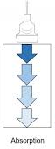
Attenuation and Absorption
Attenuation refers to loss of energy of sound wave as it travels through a medium
Mainly due to absorption but also deflection (reflection, refraction and scattering)
Attenuation of sound wave proportional to its frequency (low frequency sound waves penetrate deeper into tissue)
Bone has a high attenuation coefficient; fluid has low attenuation coefficient

Slide 29
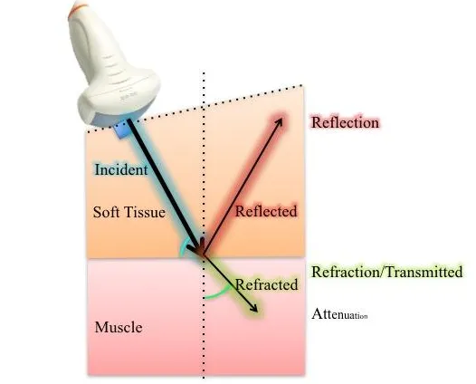
Ultrasound-Tissue Interactions
Ultrasound images are generated by sound waves reflected back to the transducer
Image quality degraded when sound waves are refracted and scattered

Slide 30
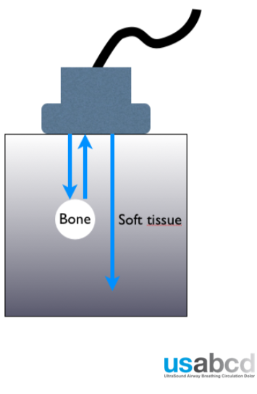
Acoustic Impedance and Reflection
Acoustic Impedance refers to resistance of the medium to vibration caused by a sound wave
Different tissues and mediums have different acoustic impedances
Ultrasound is reflected (and image generated) when it crosses boundaries between tissues with different acoustic impedances
Ultrasound wave reflected only at the interface between two tissues
Impedance mismatch between soft tissue and bone means that ultrasound cannot be used to image structures deep to bone

Slide 31
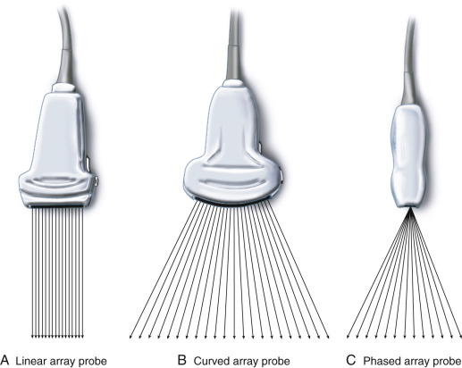
Different Types of Transducers
Transducers differ in frequency, footprint, and how piezoelectric crystals assembled in the array
Linear array:
  Ultrasound beams immitted in parallel
  Rectangular image
  High frequency (5-15 mHz) and resolution
  High resolution imaging of superficial structures (vascular)
Curved array:
  Crystals arranged in curved array
  Far field is wider than footprint of probe
  Lower frequency (2-5 MHz) used to image deeper structures
  Lower lateral resolution with increasing depth as ultrasound beams diverge

Slide 32
Different Types of Transducers
Transducers differ in frequency, footprint, and how piezoelectric crystals assembled in the array
Linear array:
  Ultrasound beams immitted in parallel
  Rectangular image
  High frequency (5-15 mHz) and resolution
  High resolution imaging of superficial structures (vascular)
Curved array:
  Crystals arranged in curved array
  Far field is wider than footprint of probe
  Lower frequency (2-5 MHz) used to image deeper structures
  Lower lateral resolution with increasing depth as ultrasound beams diverge

Slide 33
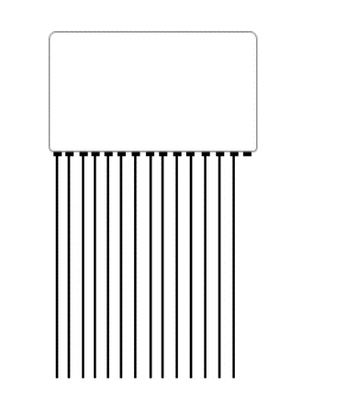
Different Types of Transducers
Transducers differ in frequency, footprint, and how piezoelectric crystals assembled in the array
Linear array:
  Ultrasound beams immitted in parallel
  Rectangular image
  High frequency (5-15 mHz) and resolution
  High resolution imaging of superficial structures (vascular)
Curved array:
  Crystals arranged in curved array
  Far field is wider than footprint of probe
  Lower frequency (2-5 MHz) used to image deeper structures
  Lower lateral resolution with increasing depth as ultrasound beams diverge

Slide 34
Different Types of Transducers
Transducers differ in frequency, footprint, and how piezoelectric crystals assembled in the array
Linear array:
  Ultrasound beams immitted in parallel
  Rectangular image
  High frequency (5-15 mHz) and resolution
  High resolution imaging of superficial structures (vascular)
Curved array:
  Crystals arranged in curved array
  Far field is wider than footprint of probe
  Lower frequency (2-5 MHz) used to image deeper structures
  Lower lateral resolution with increasing depth as ultrasound beams diverge

Slide 35
Different Types of Transducers
Transducers differ in frequency, footprint, and how piezoelectric crystals assembled in the array
Linear array:
  Ultrasound beams immitted in parallel
  Rectangular image
  High frequency (5-15 mHz) and resolution
  High resolution imaging of superficial structures (vascular)
Curved array:
  Crystals arranged in curved array
  Far field is wider than footprint of probe
  Lower frequency (2-5 MHz) used to image deeper structures
  Lower lateral resolution with increasing depth as ultrasound beams diverge

Slide 36
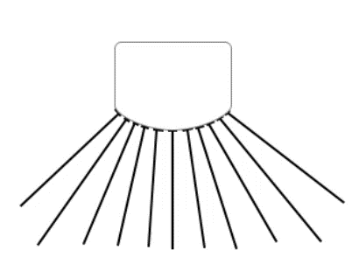
Different Types of Transducers
Transducers differ in frequency, footprint, and how piezoelectric crystals assembled in the array
Linear array:
  Ultrasound beams immitted in parallel
  Rectangular image
  High frequency (5-15 mHz) and resolution
  High resolution imaging of superficial structures (vascular)
Curved array:
  Crystals arranged in curved array
  Far field is wider than footprint of probe
  Lower frequency (2-5 MHz) used to image deeper structures
  Lower lateral resolution with increasing depth as ultrasound beams diverge

Slide 37
Different Types of Transducers
Phased array:
  Crystals are fired independently with time delays
  Ultrasound beams are electronically steered and focused
  Narrow footprint but wide field of view perfectly suited for transthoracic evaluation
  Large field of view (the heart) imaged through narrow intercostal space
  1.5 – 7 MHz

Slide 38
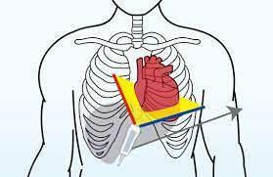
Different Types of Transducers
Phased array:
  Crystals are fired independently with time delays
  Ultrasound beams are electronically steered and focused
  Narrow footprint but wide field of view perfectly suited for transthoracic evaluation
  Large field of view (the heart) imaged through narrow intercostal space

Slide 39
ULTRASOUND OPERATING MODES
Notes:
Different operating moves permit the evaluation of different characteristics of the same structure

Slide 40
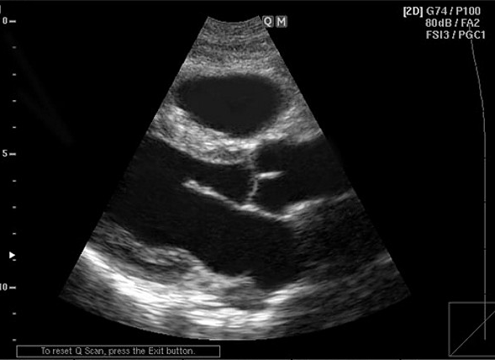
Two-Dimensional (2D) or B-Mode
Used for majority of ultrasound diagnostic imaging
Structures that transmit all sound waves without reflection (i.e fluid) appear black and referred to as anechoic
Structures that reflect relatively few sound waves are hypoechoic
Structures that reflect soundwaves similar to surrounding structures are isoechoic
Structures that reflect most sound waves (i.e.pericardium or bone) are hyperechoic

Slide 41
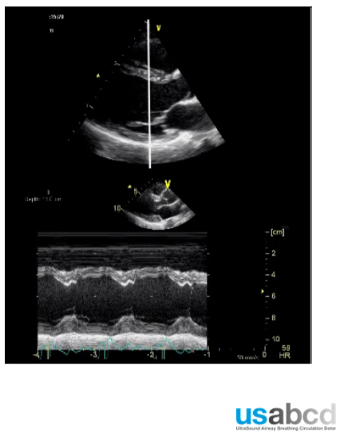
Operating Modes: M-Mode
M-mode is an abbreviation of “motion mode”
One-dimensional modality representing one-ultrasound beam
Movement of all tissue along a cursor line plotted over time
Depth = vertical axis
Time = horizontal axis
Used to quantitively measure size of chambers, assessment of LV function, movement of cardiac valves, movement of lung-pleura interface in assessment of PTX
3 cardiac cycles

