Slide 1
FAST Exam
Alok Moharir
Department of Anesthesiology
Nationwide Children’s Hospital
Columbus, OH

Slide 2
Objective
Focused Assessment with Sonography in Trauma
  Acute, Subacute thoracoabdominal trauma
Point of Care Exam
Presence of free intraperitoneal or pericardial fluid
Trauma Setting
  Indicates hemorrhage
  Can expedite emergent interventions
    Chest tubes
    Surgery
E-FAST Exam
  Includes evaluation of free fluid (pleural effusion) or air (pneumothorax) in the pleural cavity

Slide 3
Clinical Applications
Advantages:
  Simple, effective
  No radiation
    Can be repeated as desired
  Sensitive and Specific
    Proportional to extent of bleeding
Clinical Settings
  Blunt and penetrating trauma
  Unexplained hypotension
Disadvantages:
  False Negatives: Hypovolemia
  May turn from negative FAST to positive FAST after resuscitation, transfusion
  Recommend to repeat FAST exam
    Fluids
    Trendelenburg

Slide 4
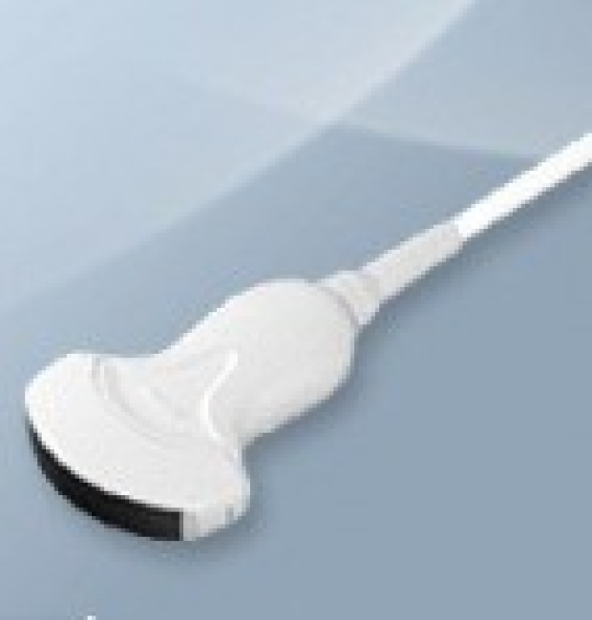
Equipment and Setup
Probe Selection: Curvilinear probe
  Low frequency: 5-2 MHz
  Deeper penetration of abdominal cavity
Orientation Indicator (OI) to left of screen
2D Mode
  Doppler, M-Mode not required

Slide 5
Patient Positioning
Most trauma patients will be supine with C-Spine immobilized
Trendelenburg position
  Increased sensitivity in detecting free fluid in upper abdomen
Reverse Trendelenburg
  Lower abdomen trauma
  Increased detection of free fluid in lower abdomen and pelvis

Slide 6
Free Fluid Accumulation
Free fluid accumulates in trauma in the following cavities:
Pericardial Cavity
  Space between parietal and visceral pericardial layers
  Surrounds the myocardium
Right Upper Quadrant
  Hepatorenal Recess (Morison’s Pouch): Area between liver and right kidney
  Subdiaphragm: Space between liver and right diaphragm
Left Upper Quadrant
  Splenorenal Recess: Area between spleen and left kidney
  Subdiaphragm: Space between spleen and left diaphragm
Pelvis
  Rectouterine Pouch: Females
  Rectovesical Pouch: Males

Slide 7
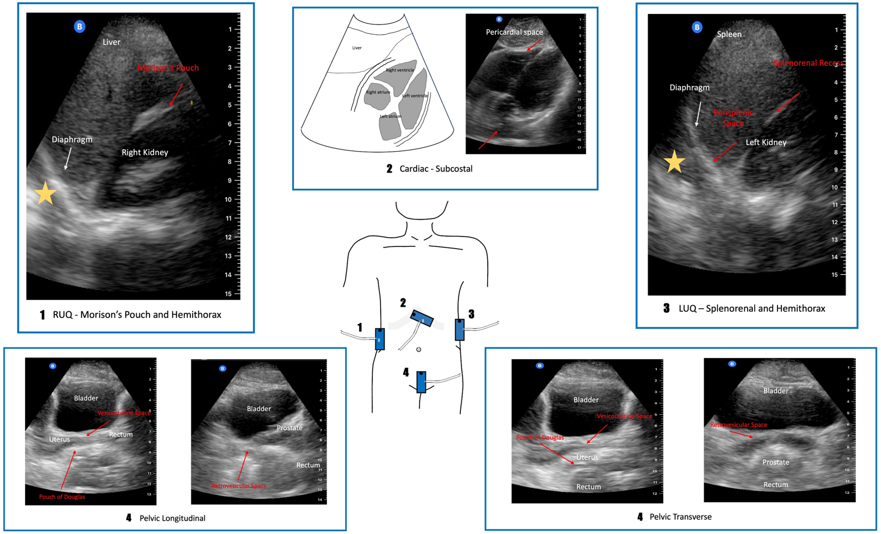
FAST Views
Right Upper Quadrant (Position 1)
Subcostal/Subxiphoid View (Position 2)
Left Upper Quadrant (Position 3)
Pelvic Views (Position 4)
  Longitudinal Scan
  Transverse Scan
Sargent A, Haskins SC, Byrne M. POCUS spotlight: focused assessment with sonography in trauma (FAST) exam. ASRA Pain Medicine News 2022;47. https://doi.org/10.52211/asra080122.037

Slide 8
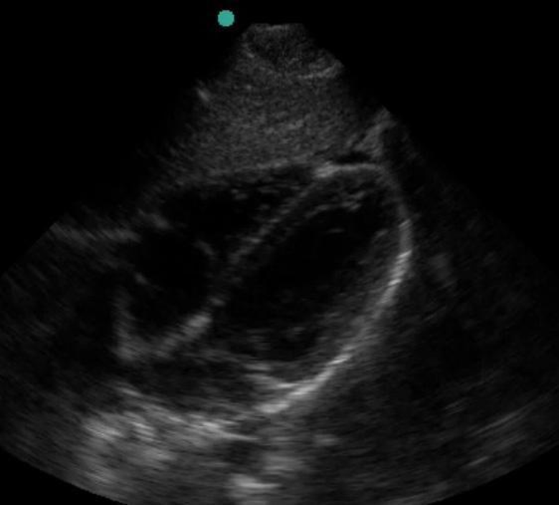
Subcostal View
Trauma Convention
  Curvilinear probe
  Orientation Indicator (blue dot) in top left of screen
  Orientation Marker of probe pointing to patient’s right shoulder
Opposite of Phased Array (Cardiac) probe:
  Orientation Marker points to patient’s left shoulder
  Orientation Indicator in top right corner of screen
Doug Franzen. FAST Exam. Referenced on February 12, 2025.
https://www.saem.org/about-saem/academies-interest-groups-affiliates2/cdem/for-students/online-education/m3-curriculum/bedside-ultrasonagraphy/fast-exam

Slide 9
Subcostal View: Sonoanatomy
Target: 4 Chamber view
Liver as an “acoustic window”
Relevant structures to identify
  Liver
  Apex of Heart: top right of screen
  Base of Heart: bottom of screen
  Right Atrium (RA)
  Right Ventricle (RV)
  Left Atrium (LA)
  Left Ventricle (LV)
  Pericardium: bright white line
Free fluid collects between heart and pericardium
Liver
RV
LV
RA
LA
Pericardium

Slide 10
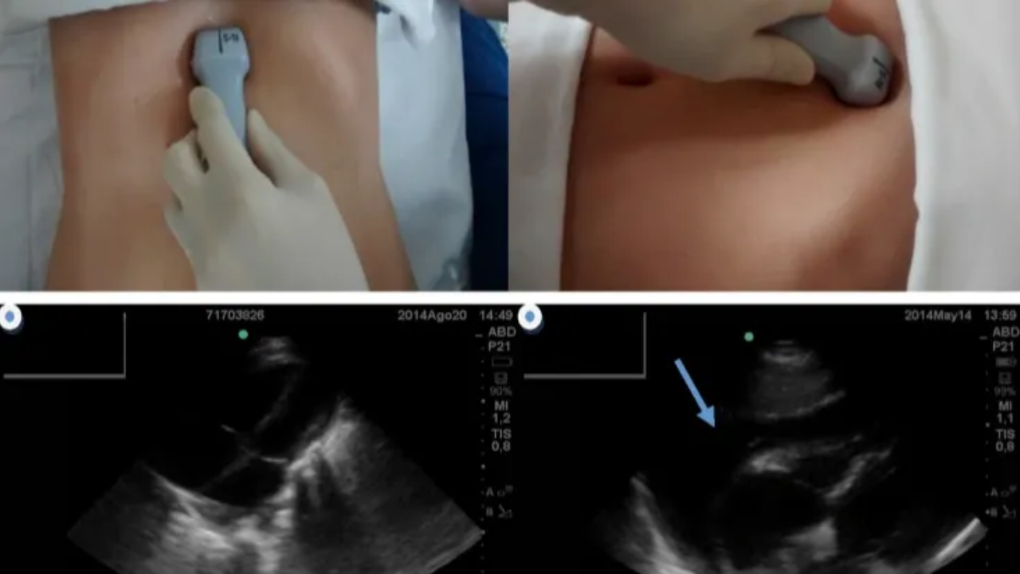
Subcostal View: Image Acquisition
Starting Position
  Transducer in subxiphoid position
  Orientation Marker towards patient’s right shoulder
    Opposite of TTE with phased array probe
Probe held like a screwdriver prone
Probe Manipulation
  Tilt imaging plane upwards
  Towards left shoulder
  Rotation clockwise-counterclockwise to maximize view
Depth: 16-24 cm (adult patient)
Optimal View: All 4 chambers of heart fully open

Slide 11
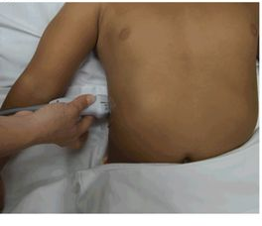
RUQ View
Transducer along right posterior axillary line
Orientation Marker of probe pointing towards patient’s head

Slide 12
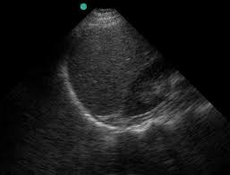
RUQ View: Sonoanatomy
Diaphragm: White hyperechoic curved line above the liver
Liver: Homogenous tissue
  Small hypoechoic dots
    Liver Veins
    Bile Ducts
Right Kidney: Hyperechoic calyces and kidney pelvis
Morrison’s Pouch
  Hepatorenal Recess
  Hyperechoic white streak
Spine: Deep to intra-abdominal organs
Kidney
Liver
Diaphragm
Morrison’s Pouch
Spine

Slide 13
RUQ: Image Acquisition
Obtain Liver and Kidney view in right posterior axillary line
  T11/T12 Level
  Avoid rib shadowing
  Align, rotate, tilt transducer to maximize view
Slide transducer cranially to view Diaphragm
  Sweep anterior and posterior to view entire subdiaphragm
Slide caudally to obtain Hepatorenal Recess
  Sweep anterior and posterior to obtain entire view
Move transducer medially to view free margin of liver

Slide 14
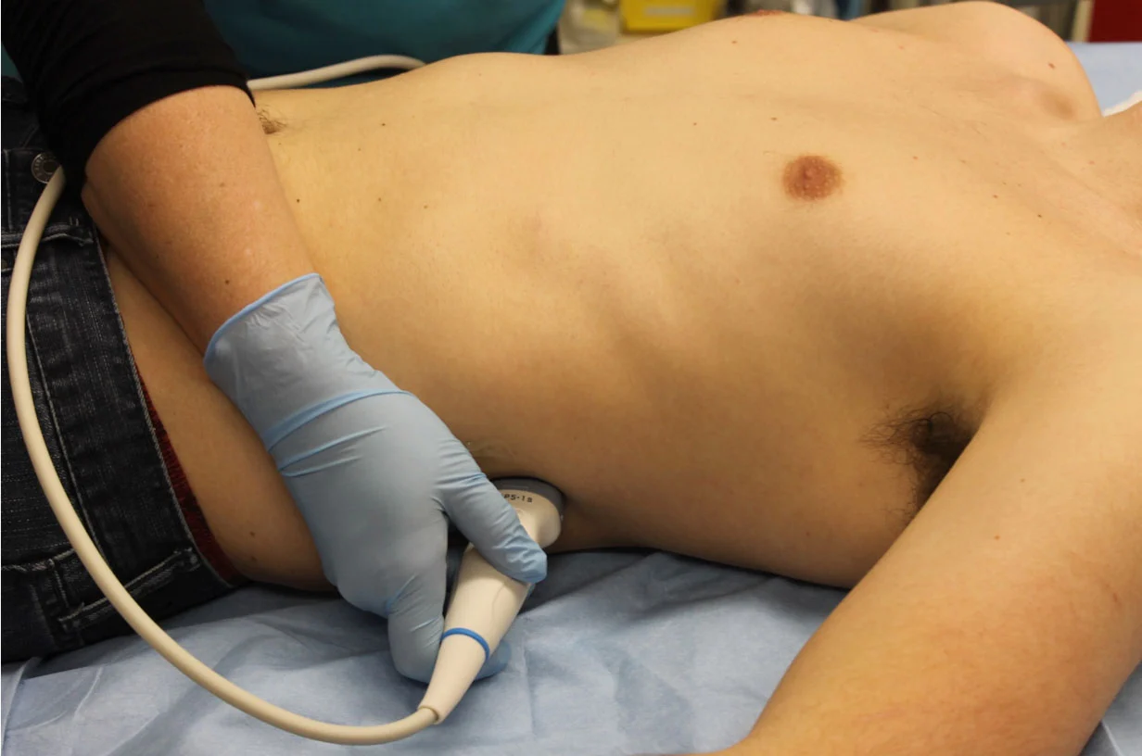
LUQ View
Transducer placed in left posterior axillary line
Orientation Marker (OM) of transducer pointing towards head

Slide 15
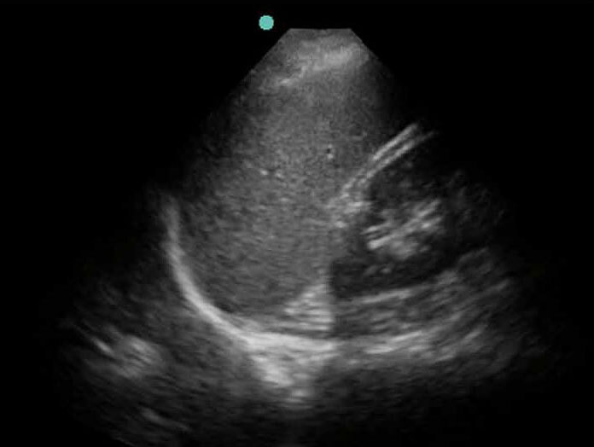
LUQ View: Sonoanatomy
Diaphragm on left side of screen
  White hyperechoic curved line
  Located above the spleen
Spleen
  Homogenous texture
  Absence of vessels and ducts when compared to the liver
Left Kidney
  Kidney Bean form
  Hyperechoic calyces, kidney pelvis
Splenorenal Recess
  Hyperechoic white streak
Spine: Deep to intra-abdominal organs
Splenorenal Recess
Spleen
Left
Kidney
Diaphragm
Spine

Slide 16
LUQ View: Image Acquisition
Obtain Spleen and Kidney view in left posterior axillary line
  T11/T12 Level
  Avoid rib shadowing
  Align, rotate, tilt transducer to maximize view
Slide transducer cranially to view Diaphragm
  Sweep anterior and posterior to view entire subdiaphragm
Slide caudally to obtain Splenorenal Recess
  Sweep anterior and posterior to obtain entire view

Slide 17
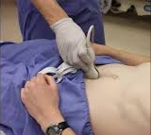
Pelvic View
Midabdomen
  Above pubic symphysis
Two views
  Transverse
  Longitudinal
Orientation Indicator on top left of screen
Transverse View
  OM directed toward patient’ right side
  Horizontal plane
Longitudinal View
  OM directed toward patient’s head
  Sagittal Plane

Slide 18
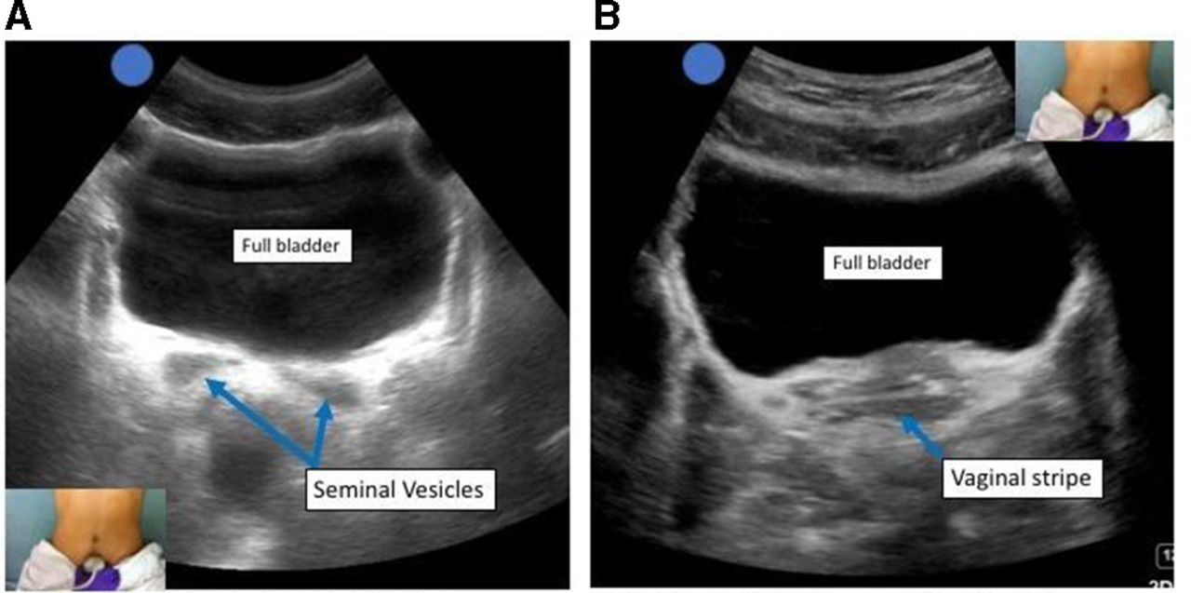
Pelvic View: Transverse (Males)
Transducer placed midline
  Just above pubic symphysis
  Transverse plane
  May need to tilt downwards to maximize bladder view
Target View
  Bladder in center of screen
  Prostate, Seminal Vesicles posterior to Bladder
Prostate
  Homogenous
  Round or Ovoid
Seminal Vesicles
  Anechoic
  Bow-Tie appearance on each side of prostate
Manson WC et al. Focused Assessed Sonography in Trauma (FAST) for the Regional Anesthesiologist and Pain Specialist. Regional Anesthesia and Pain Medicine 2019; 44: 540-548.
R
Prostate

Slide 19
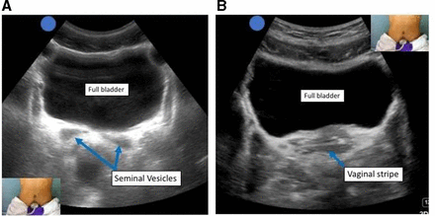
Pelvic View: Transverse (Females)
Bladder fully visualized
Vaginal Stripe posterior to Bladder
Manson WC et al. Focused Assessed Sonography in Trauma (FAST) for the Regional Anesthesiologist and Pain Specialist. Regional Anesthesia and Pain Medicine 2019; 44: 540-548.

Slide 20
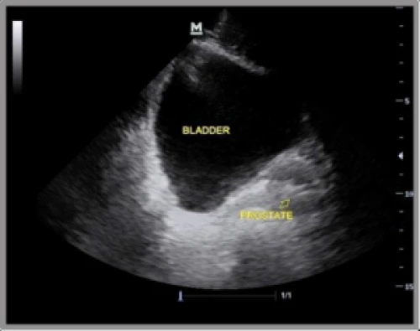
Pelvic View: Longitudinal (Males)
Transducer in the midline sagittal plane
  Just above pubic symphysis
Can start in transverse view
  Rotate transducer 90 degrees
Orientation Marker towards patient’s head
Jennifer Cotton. Life in the FAST Lane: Sonography for Trauma. Referenced on February 18, 2025. https://www.sonomojo.org/life-in-the-efast-lane-extended-focused-assessment-with-sonography-for-trauma-part-2/

Slide 21
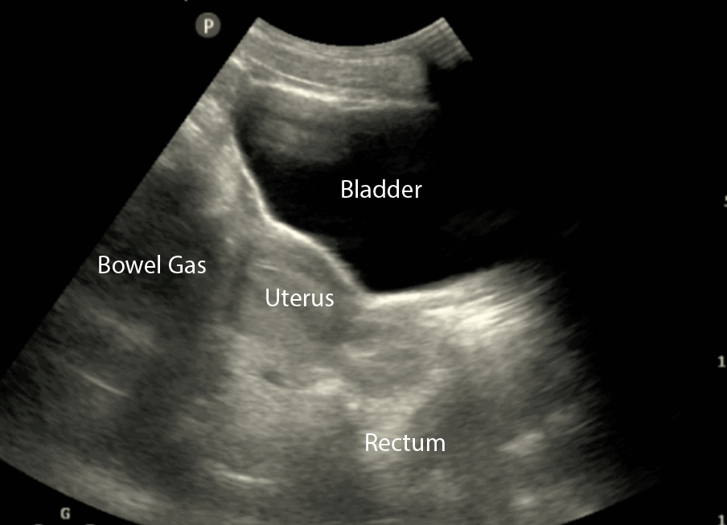
Pelvic View: Longitudinal (Females)
Bladder
Uterus
Vaginal Stripe
  Hyperechoic Stripe
  Within Vaginal Canal
Rectouterine Pouch
  Pouch of Douglas (POD)
  Most dependent portion of Pelvis in females
  First area to collect pelvic fluid
Manson WC et al. Focused Assessed Sonography in Trauma (FAST) for the Regional Anesthesiologist and Pain Specialist. Regional Anesthesia and Pain Medicine 2019; 44: 540-548.
Vaginal Stripe
POD

Slide 22
FAST Exam Pathology
Questions to ask
  Fluid in the abdomen?
  Fluid in the pericardium?
  Fluid in the pleural cavities?
Indicates possible bleeding:
  Surgery
  CT
  Diagnostic Peritoneal Lavage (DPL)

Slide 23
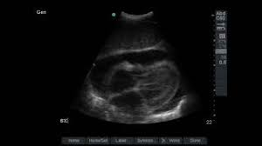
Pericardial Fluid
Black, anechoic stripe
Splits bright white line between the liver and the heart (top of screen)
Separates bright pericardium from grey myocardium (bottom of screen)
More pronounced in inspiration: Pushes diaphragm, heart down
Pericardial
Fluid
Liver

Slide 24
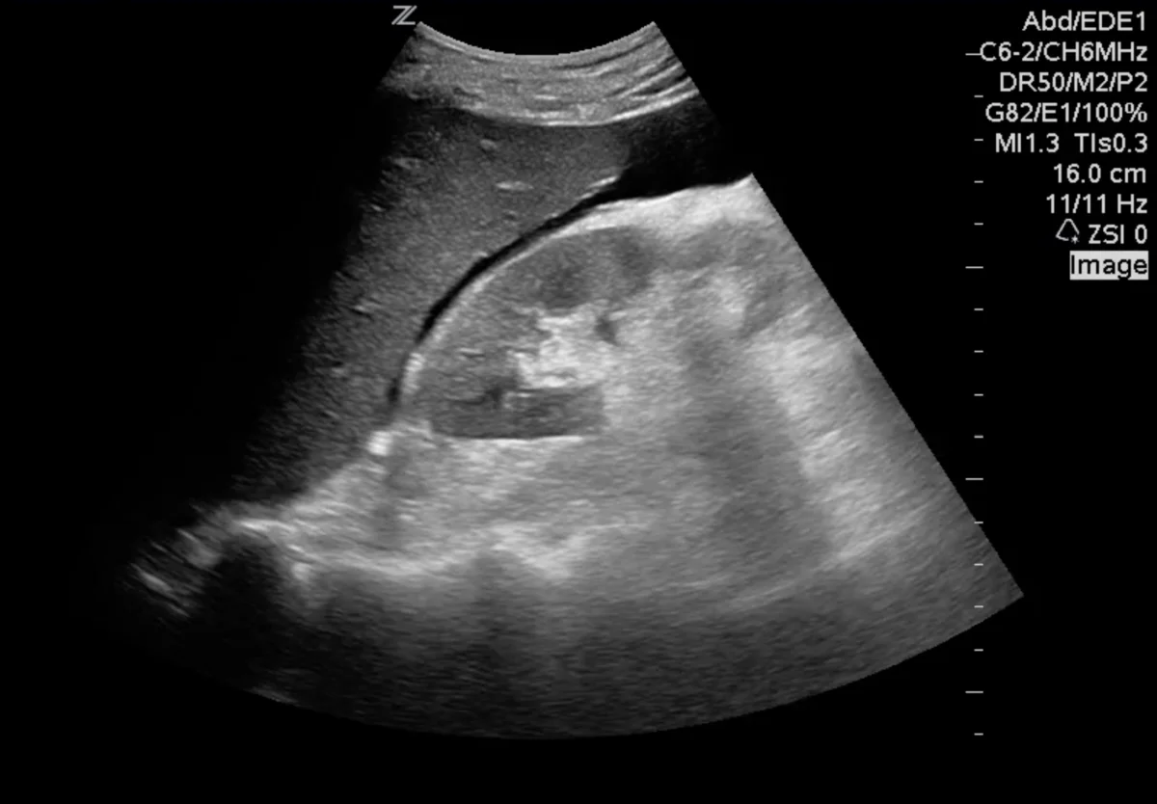
RUQ Pathology
Identify the free margin of the Liver
  Sensitive for intra-abdominal fluid collection
Sensitive areas:
  Hepatorenal recess (Morrison’s Pouch)
    Marked by anechoic black stripe (yellow arrows)
  Subdiaphragmatic space
E-Fast exam: Free fluid in the pleural cavity above the diaphragm
Craig Brick. Clinical Ultrasonography 101. Referenced on February 28, 2025. https://canadiem.org/right-upper-quadrant-scans-go-wrong/

Slide 25
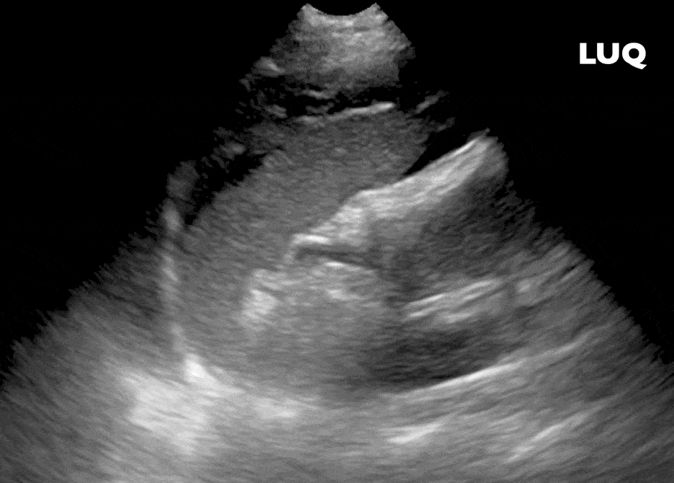
LUQ Pathology
Fluid appears as a black, anechoic stripe
Perisplenic Space is most sensitive (yellow arrows)
Less likely in Splenorenal Space (due to presense of Splenorenal Ligament)
E-FAST: Free fluid in the pleural cavity above the diaphragm
White S, Dinh V. FAST Scan. Referenced on February 20, 2025. https://www.pocus101.com/efast-ultrasound-exam-made-easy-step-by-step-guide/

Slide 26
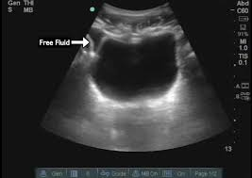
Pelvic Pathology
Free fluid anterior, posterior, or lateral to the bladder
  Make sure that lateral edges are visualized
Black, anechoic stripe
Nomura J. Pelvic Views during FAST Exam. Referenced on February 20, 2025. https://takeokun.com/blog/2015/12/4/tips-and-tricks-for-the-pelvic-views-during-the-fast-exam

Slide 27
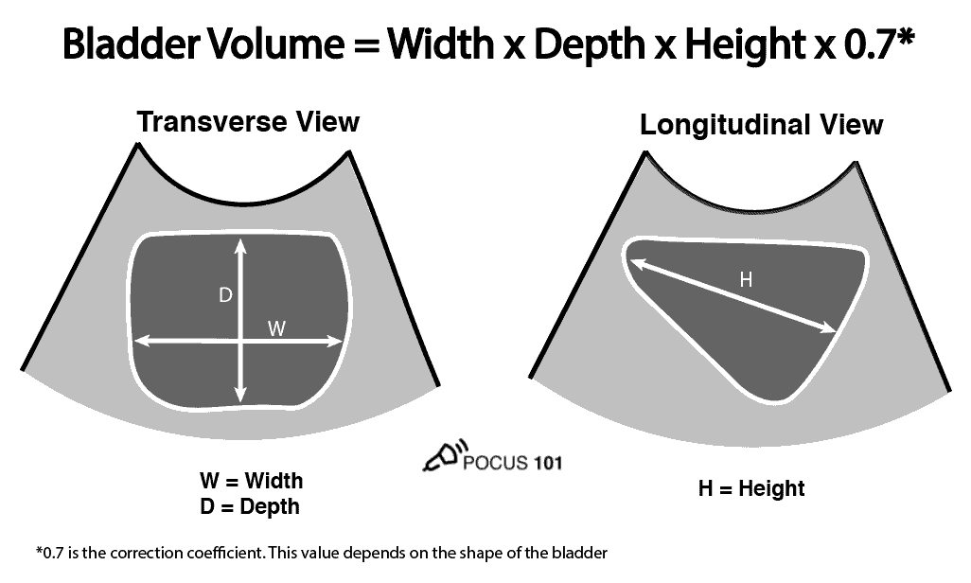
Bladder Assessment
Bladder Volume (ml) = Width (cm) X Depth (cm) X Height (cm) X 0.7
Adults:
  Volume > 500 ml can lead to Detrusor muscle injury
  Recommend to decompress with Foley
Dinh V. Bladder Volume Ultrasound Calculator. Referenced on February 20, 2025. https://www.pocus101.com/bladder-volume-ultrasound-calculator/

Slide 28
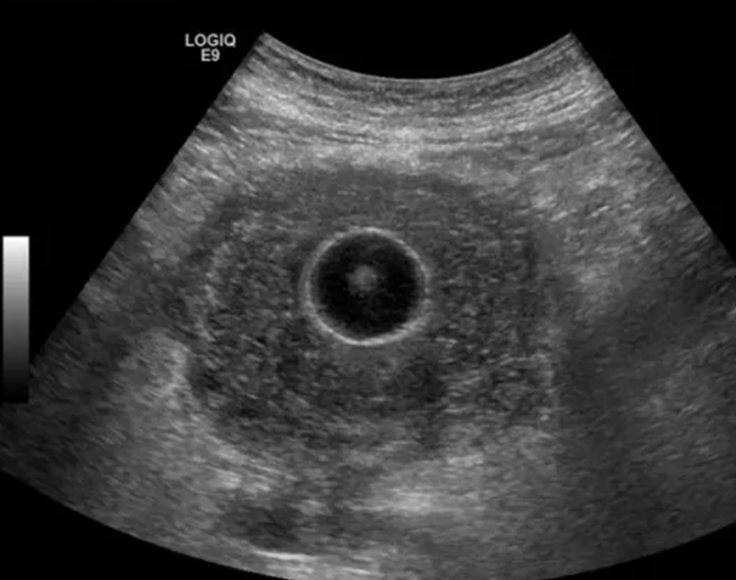
Foley Catheter
Inflated Cuff should be visible in bladder
Bladder should be decompressed
Oliguria with a decompressed bladder:
  Indicates pathology proximal to bladder
  Differential Diagnosis:
    Prerenal failure
      Hypovolemia
      Sepsis
    Intrinsic Renal failure
    Bilateral Ureteral Obstruction
Koratala A. Nephropocus. Referenced on February 20, 2025. https://nephropocus.com/2019/06/21/urinary-bladder-wall-thickness-what-is-the-number-to-remember/
Foley Catheter Balloon

Slide 29
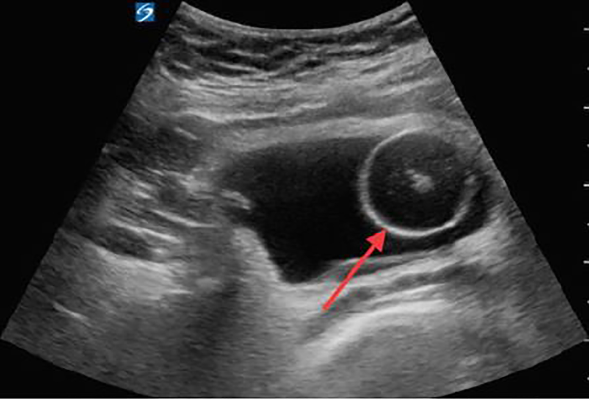
Foley in a Distended Bladder
Indicates kinked or obstructed catheter
Management:
  Flush the Foley
  Trace the catheter: Evaluate for kinks
Urine
Foley Catheter Balloon

