Slide 1
Anesthetic Considerations For Scoliosis Repair in Pediatric Patients
Jina Sinskey, MD
Andrew Infosino, MD
UCSF Department of Anesthesia and Perioperative Care
Updated 5/2018

Slide 2
Disclosures
None

Slide 3
Learning Objectives
Classify the different types of scoliosis
Identify the different treatment options for scoliosis
Summarize the preoperative assessment process for scoliosis patients
Recognize the intraoperative issues specific to scoliosis repair including neuromuscular monitoring
Review postoperative issues after scoliosis surgery

Slide 4
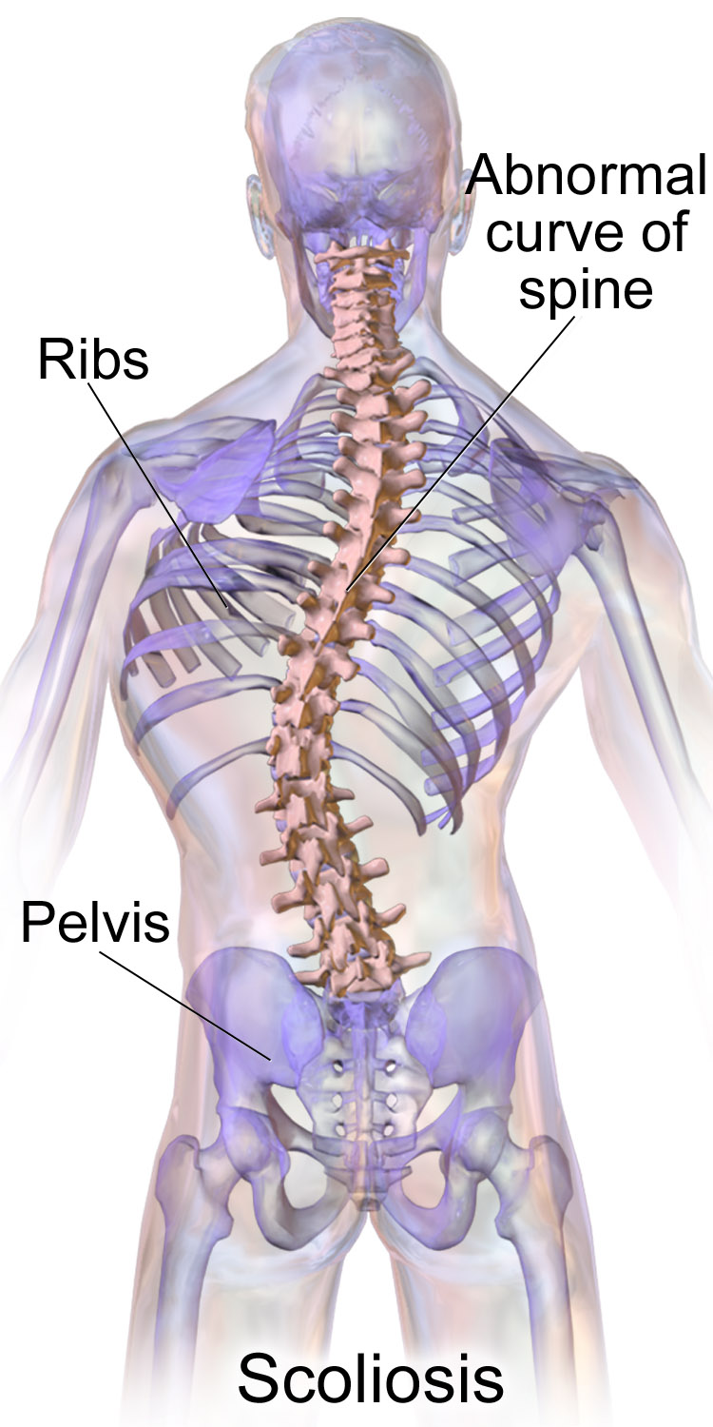
Types of Scoliosis
Congenital scoliosis
Idiopathic scoliosis
Neuromuscular scoliosis
Syndromic scoliosis
Acquired scoliosis: fractures, radiation, tumor or infection
https://commons.wikimedia.org/wiki/File%3ABlausen_0785_Scoliosis_01.png

Slide 5
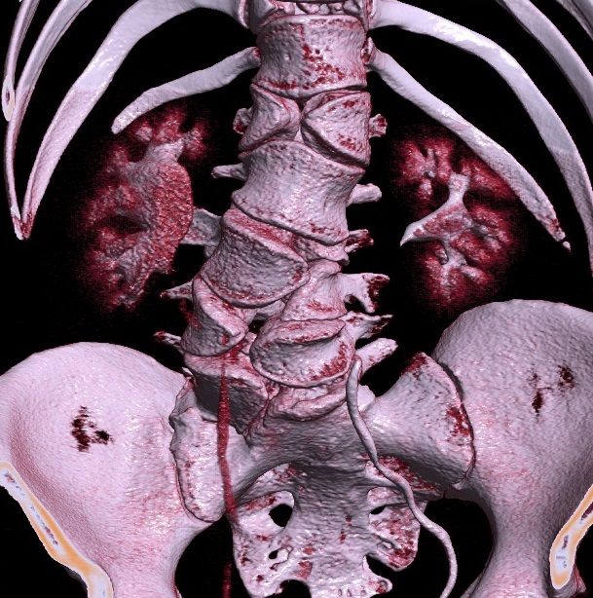
Congenital Scoliosis
Least common form of scoliosis
Failure of vertebrae to form normally (hemi-vertebrae, butterfly vertebrae)
Associated with other congenital abnormalities (e.g. VACTERL)
CT Rendering of Butterfly Vertebrae
https://commons.wikimedia.org/wiki/File%3AVolume_rendering_of_CT_of_butterfly_vertebrae.jpg

Slide 6
Idiopathic Scoliosis
Most common form of scoliosis
Affects both genders equally, but more likely to progress in females
Subdivided by age of diagnosis
Infantile: before age 4
Juvenile: between ages of 4 - 10
Adolescent: between ages of 10 - 18

Slide 7
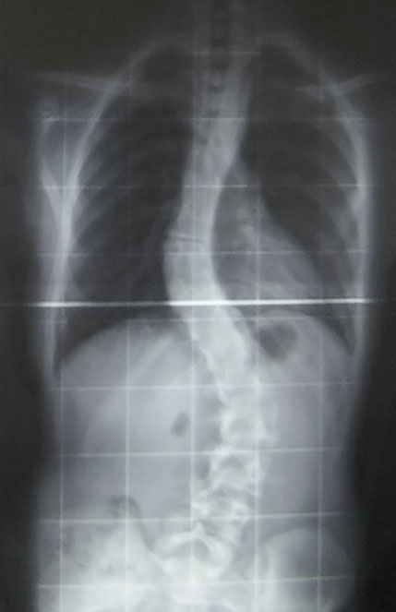
Idiopathic Scoliosis
Earlier onset is associated with larger curvature
Larger thoracic curvature is associated with more severe restrictive lung disease
Larger curvature at presentation is associated with greater curve progression
Growth often amplifies curvature
Curve progression is more common in females
https://commons.wikimedia.org/wiki/File%3AWiki_pre-op.jpg

Slide 8
Neuromuscular Scoliosis
Associated with underlying nerve/muscle condition:
Neuropathies: cerebral palsy, spinal muscular atrophy, spina bifida
Myopathies: muscular dystrophies
Muscles become weak, spastic or paralyzed → unable to support the spine

Slide 9
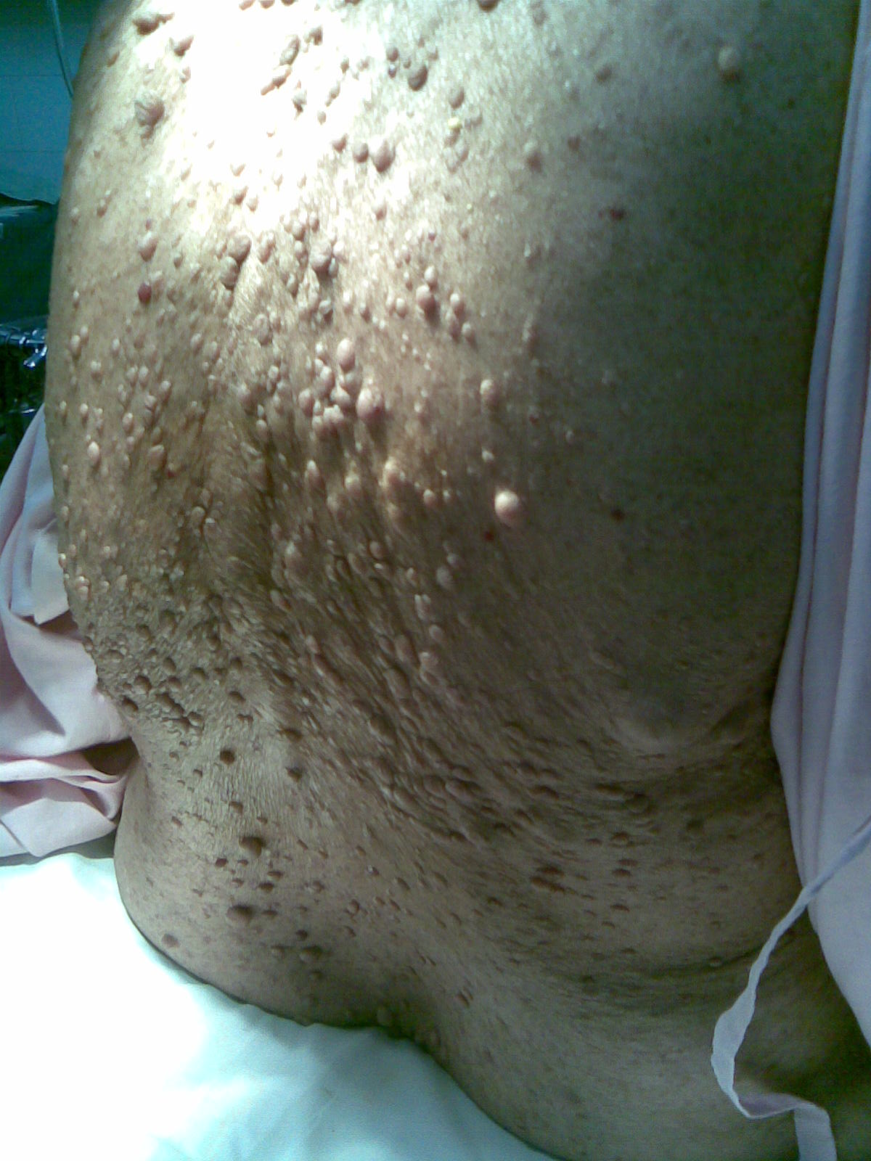
Syndromic Scoliosis
Scoliosis can occur as part of many syndromes
Examples include skeletal dysplasias, Marfan syndrome, neurofibromatosis
Neurofibromatosis Type 1
https://commons.wikimedia.org/wiki/File%3ANeurofibromatosis.jpg

Slide 10
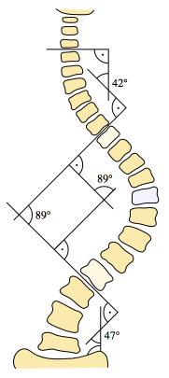
Measuring the Severity of the Scoliosis Curve – The Cobb Angle
If > 45°: surgical treatment recommended
If > 60°: abnormal PFTs from restrictive pulmonary disease
If > 100°: symptomatic restrictive pulmonary disease
Cobb Angle
https://commons.wikimedia.org/wiki/File%3AScoliosis_cobb.svg
Notes:
To measure the Cobb angle, choose the most tilted vertebrae above and below the apex of the curve. A line is drawn parallel to the top of most tilted vertebra above the apex and a second line is drawn parallel to the bottom of the most tilted vertebra below the apex. The angle at which these two lines intersect is the Cobb angle.

Slide 11
Natural History of Scoliosis
If untreated, scoliosis may progress, especially in patients with larger curves, and lead to:
Restrictive lung disease
Back pain
Cosmetic and body image issues

Slide 12
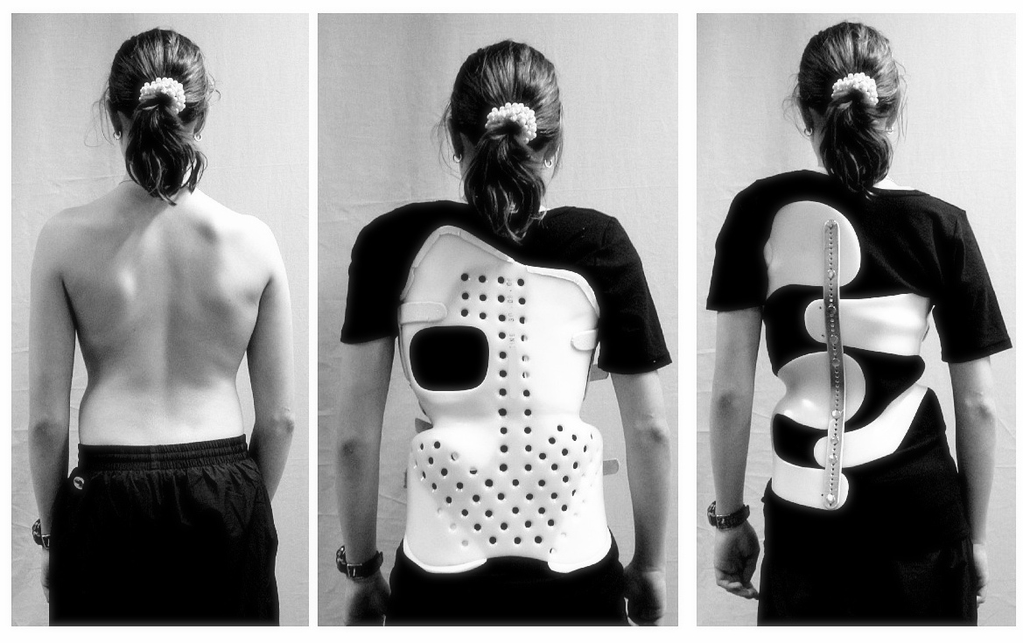
Scoliosis Treatment Options
Non-Surgical:
Observation if curve is < 30°: serial X-rays every 6 months until growth is complete
Bracing if curve is from 30 - 50°
Serial casting has been used to treat progressive infantile idiopathic scoliosis
https://commons.wikimedia.org/wiki/File%3AScoliosis_brace.jpg

Slide 13
Surgical Treatment of Scoliosis
Traditional technique: spinal fusion with instrumentation
Posterior approach
Anterior approach
Combined posterior and anterior approach in either a single procedure or staged procedures

Slide 14
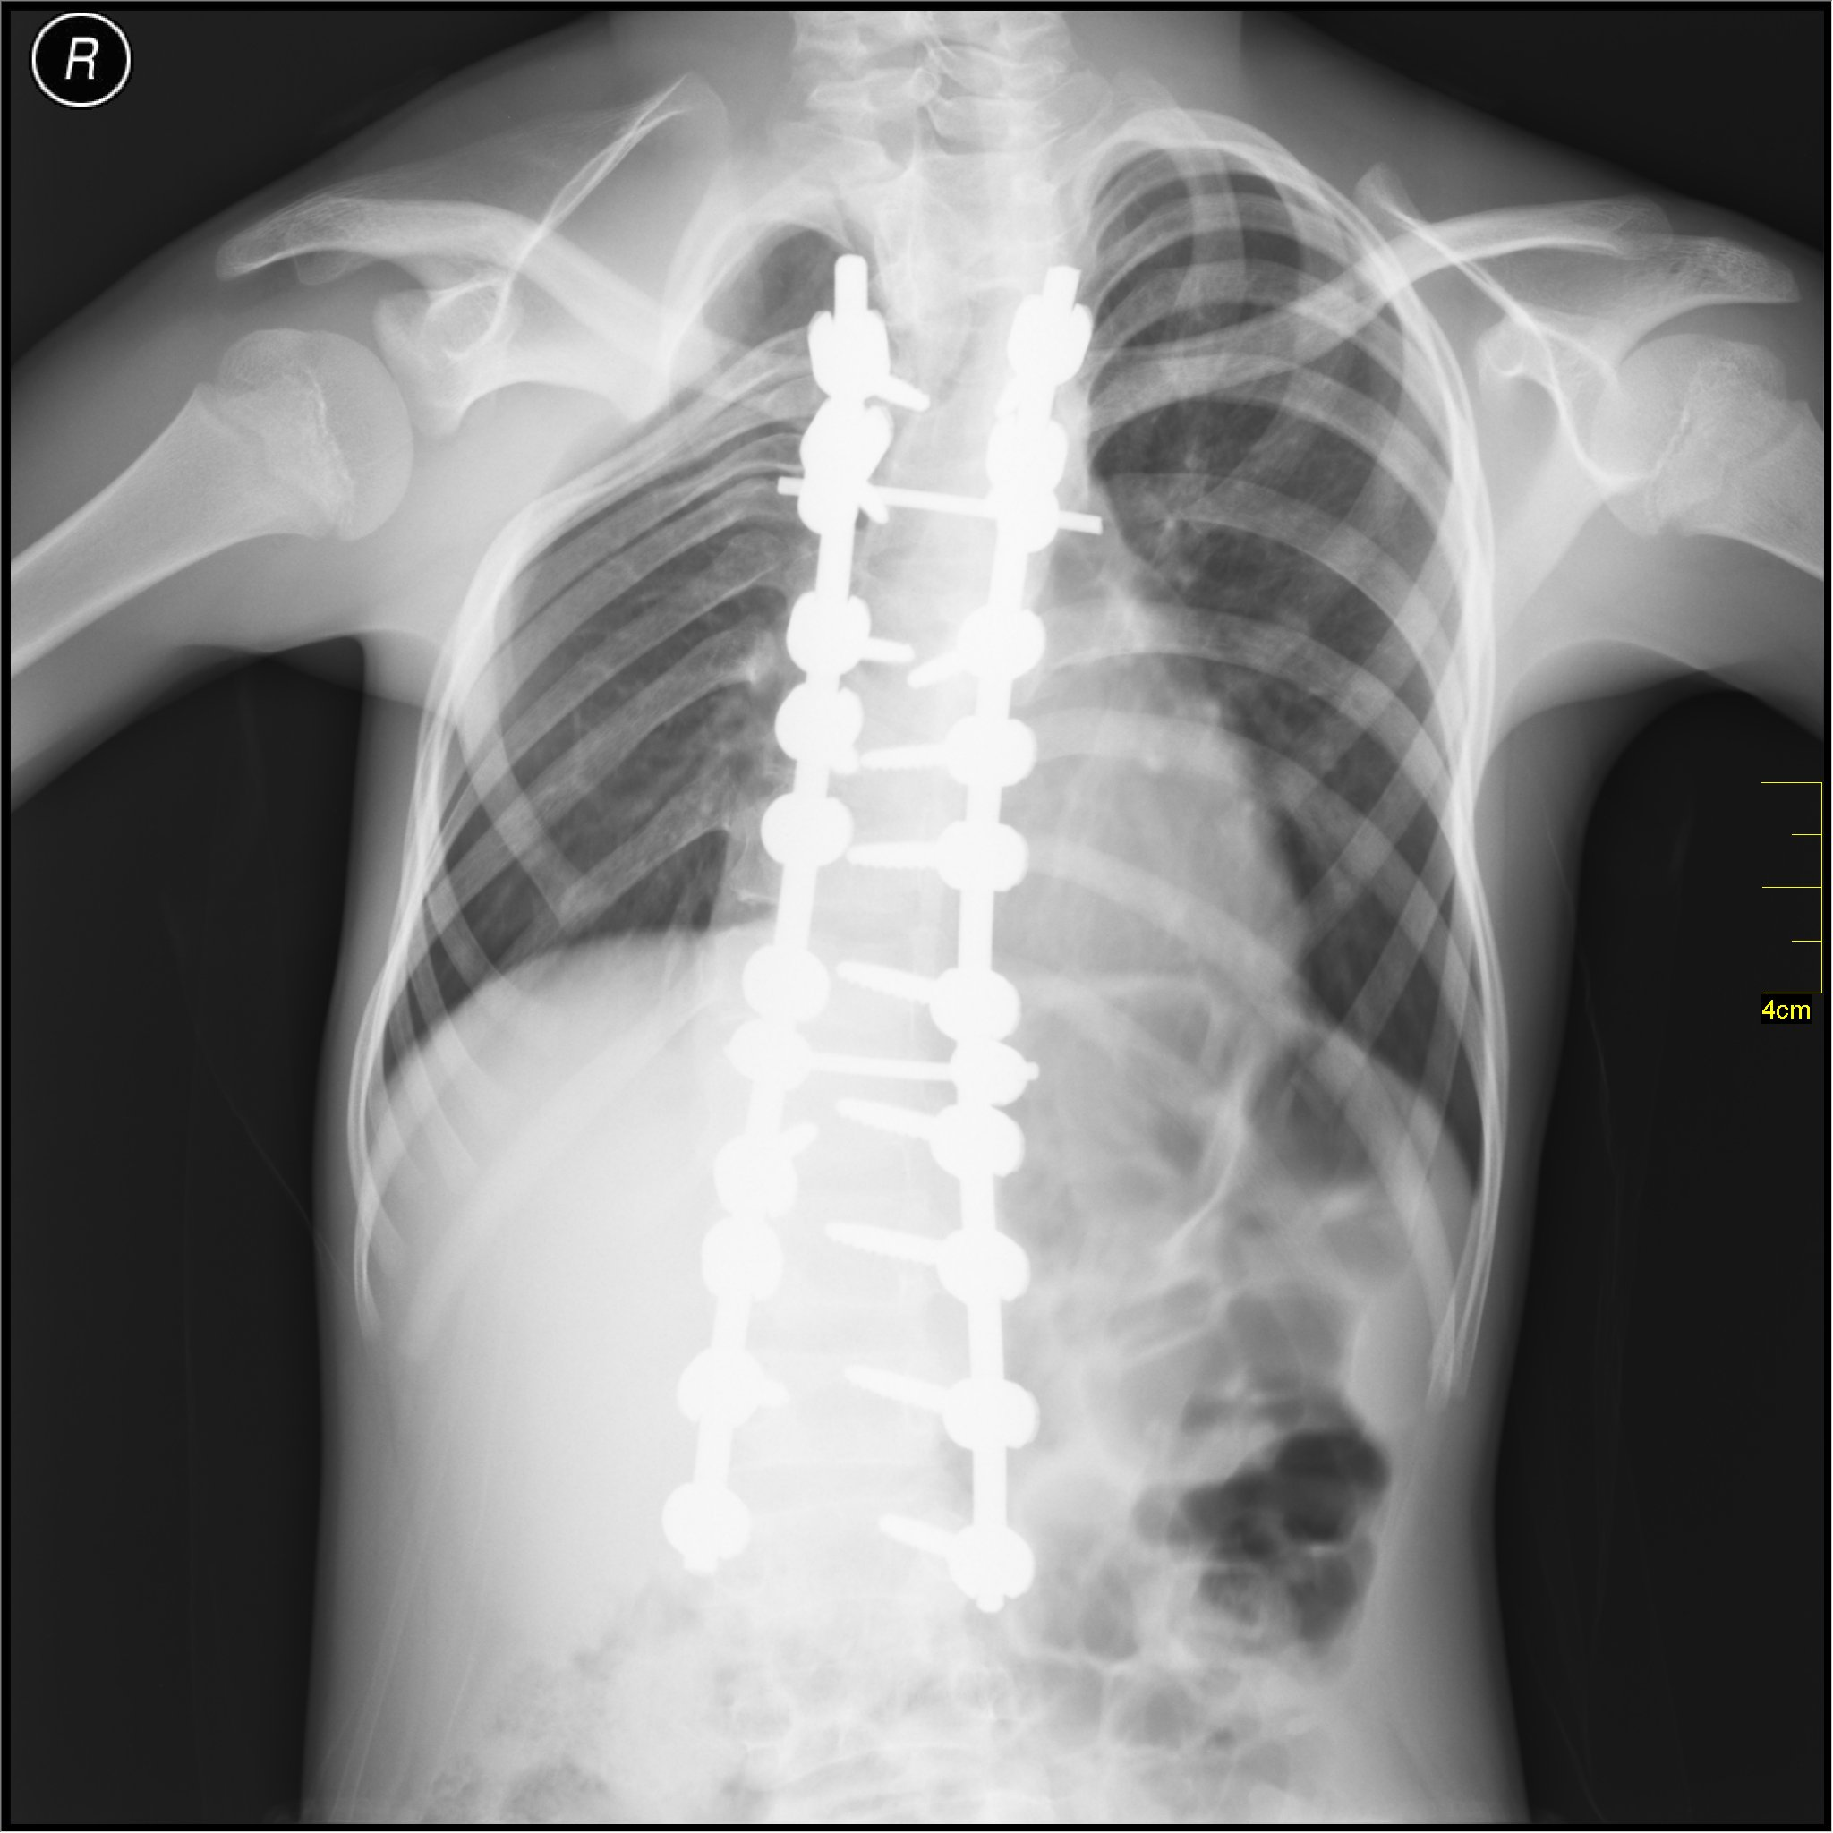
Spinal Fusion with Instrumentation
Attach pedicle screws to secure rods to spine
Decrease curvature and rotational deformity
Bone graft to fuse all vertebrae involved in instrumentation
https://commons.wikimedia.org/wiki/File%3AMedical_X-Ray_imaging_AOX02_nevit.jpg

Slide 15
Surgical Treatment of Scoliosis
Growing Rods:
Performed on skeletally immature patients
Allows for continued growth of the spine
1-2 contoured rods are attached to the spine at the top and bottom of the curve
Serial surgeries slowly distract the spine
Followed by definitive fusion at skeletal maturity

Slide 16
Preoperative Assessment
All patients:
Complete history and physical exam
Preoperative hemoglobin, hematocrit and platelet count
Type and cross to blood bank
https://commons.wikimedia.org/wiki/File%3ABlausen_0086_Blood_Bag.png

Slide 17
Preoperative Assessment
If neuromuscular or syndromic may have more severe restrictive lung disease
Consider PFTs
Discuss need for possible postoperative intubation with patient and family
Plan for postoperative ICU admission

Slide 18
Muscular Dystrophy Patients
May have cardiomyopathy and need a preoperative echocardiogram
In cases of severe cardiomyopathy, risks may outweigh benefits of surgery
Are often weaker and may need postoperative ventilation and ICU
Avoid Succinylcholine as it is associated with life-threatening hyperkalemia
https://commons.wikimedia.org/wiki/File%3ASuccinylcholine_1(cropped).jpg

Slide 19
Intraoperative Management
General endotracheal anesthesia with positive pressure ventilation
If anterior surgery will need lung isolation
At least 2 large bore intravenous catheters for volume resuscitation and for medication infusions
Consider arterial catheter for blood pressure management and blood sampling

Slide 20
Prone Positioning for PSF
Prone headrest to eliminate pressure on eyes and nose
Bilateral bite blocks when MEPs are used to prevent tongue injury/laceration
Neck in neutral position
Longitudinal bolsters to support trunk, minimize abdominal compression and optimize ventilation
Position arms anteriorly and minimize brachial plexus injury: shoulders abducted less than 90°

Slide 21
Potential Intraop Complications
Significant blood loss
Spinal cord injury including paralysis
Nerve root injury
Dural tears
Ophthalmologic injury
Brachial plexus injury
Pressure ulcers or skin damage

Slide 22
Average Estimated Blood Loss Varies by Scoliosis Type
Scoliosis Type | EBL
Adolescent Idiopathic | 1500 mL total 120 mL per level
Spastic Neuromuscular (e.g., cerebral palsy) | 2500 mL total 180 mL per level
Paralytic Neuromuscular (e.g., muscular dystrophy, spinal muscular atrophy) | 3500 mL total 220 mL per level

Slide 23
Perioperative Management of Blood Loss for Scoliosis Surgery
Type and cross match blood products from blood bank
Consider autologous predonation
Consider directed blood donation
Intraoperative blood salvage if available
Anti-fibrinolytic agents to minimize blood loss: aminocaproic acid or tranexamic acid

Slide 24
Intraoperative Neuromonitoring to Minimize Spinal Cord Injury
Detection of neurologic changes in a timely manner
Provides opportunity for prompt intraoperative intervention to reverse neurological deficits

Slide 25
Intraoperative Spinal Cord Injury
Accidental direct contusion of the cord from surgical instruments, hooks, wires or pedicle screws
Excessive stretch to spinal cord from a deformity correction maneuver
Reduction in spinal cord blood flow from intraoperative hypotension or accidental surgical injury to the spinal cord blood supply

Slide 26
Neuromonitoring Modalities for Scoliosis Surgery
Motor Evoked Potentials (MEPs): stimulate scalp electrodes and monitor muscle electrodes
Somatosensory Evoked Potentials (SSEPs): stimulate motor electrodes and monitor scalp electrodes
Evoked Electromyelograms (EMGs): check for proper pedicle screw placement
Wake-up Test: Used less commonly with the availability of MEPs, SSEPs, and EMGs

Slide 27
Intraoperative Management
If using MEPs, SSEPs or EMGs avoid using muscle relaxants and minimize inhalational agents. Maintain anesthesia with fentanyl and propofol infusions.
If planning wake-up test use short acting agents. Consider maintaining anesthesia with propofol and remifentanil infusions.

Slide 28
Improving Neuromonitoring Signals
Maintain hemodynamic stability
Maintain MAP at least 65-75 mmHg
Consider tranexamic acid infusion to minimize blood loss (antifibrinolytic)
Phenylephrine infusion may help maintain vascular resistance
May need to transfuse blood products
https://commons.wikimedia.org/wiki/File%3ATranexamic_acid_(cropped).jpg

Slide 29
Improving Neuromonitoring Signals
Limit agents that suppress signals
Minimize inhaled anesthetic agents (< 0.3 MAC)
Avoid nitrous if using SSEPs
Avoid neuromuscular blockade if using MEPs and/or EMGs
Use agents that improve signals
Consider a ketamine infusion

Slide 30
Wake-Up Test
Rehearse with patient preoperatively
Wake patient up during and immediately after completion of scoliosis surgery
Requires two people: One person at head of bed, one person to observe lower extremities
Control: Ask patient to squeeze both hands
Test: Ask patient to move both feet
Have propofol connected to IV to re-anesthetize patient immediately after wake-up test

Slide 31
Postoperative Management
Monitor neurological exam:
Postoperative epidural hematoma can result in spinal cord injury
Postoperative hypotension can result in spinal cord ischemia
Pain control: consider epidural or patient controlled analgesia (PCA) with opiates as well as other non-opiate adjuncts
Give antiemetics to prevent/treat postoperative nausea and vomiting
Early ambulation

Slide 32
Postop Pulmonary Issues
High risk of respiratory failure requiring postop ventilation in neuromuscular scoliosis patients due to pre-existing muscle weakness
Consider noninvasive positive pressure ventilation (e.g., BiPAP) or cough assist if preop FVC < 30%
FVC and FEV1 decrease postop even in idiopathic scoliosis patients:
Up to 60% decline with nadir at 3 days
Back to baseline in 1-2 months
https://commons.wikimedia.org/wiki/File%3AFlow-volume-loop.svg

Slide 33
Scoliosis Surgery Complications
Retrospective review of 19,360 patients
 | Idiopathic | Congenital | Neuromuscular | Other* | All Patients
New neurologic deficit | 0.8% | 2.0% | 1.1% | 1.6% | 1.0%
Pulmonary (excluding pulmonary embolus) | 0.6% | 1.1% | 1.9% | 1.8% | 1.0%
Death | 0.02% | 0.30% | 0.34% | 0.1% | 0.13%
Total complications | 6.3% | 10.6% | 17.9% | 14.5% | 10.2%
*Other: Post-traumatic, syndromic (Down, Marfan, Ehlers–Danlos), neurofibromatosis, non-neurological tumor, iatrogenic, bone dysplasias/dwarfism
Source: Reames DL, et al. Complications in the surgical treatment of 19,360 cases of pediatric scoliosis: a review of the Scoliosis Research Society Morbidity and Mortality Database. Spine. 36:1484-1491. 2011

Slide 34
References
Murphy RF, Mooney JF. Complications following spine fusion for adolescent idiopathic scoliosis. Curr Rev Musculoskelet Med. 2016 Dec; 9(4): 462-469.
Diab M, Staheli LT. (2016) Practice of Paediatric Orthopaedics. Third Edition. Philadelphia, PA: Wolters Kluwer.
Modi HN, et al. Intraoperative blood loss during different stages of scoliosis surgery: A prospective study. Scoliosis. 2010 Aug 7;5:16.
Yuan N, et al. The effect of scoliosis surgery on lung function in the immediate postoperative period. Spine 2005. 30:2182-5.
Reames DL, et al. Complications in the surgical treatment of 19,360 cases of pediatric scoliosis: a review of the Scoliosis Research Society Morbidity and Mortality Database. Spine. 36:1484-1491. 2011

